Slide 1
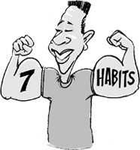
7 Habits of Highly Effective Teens
Career Life Education 10

Slide 2
What are the 7 Habits?
They are a set of tools to help teens deal with real life
They can also be looked at as seven characteristics that happy and successful teens have in common

Slide 4
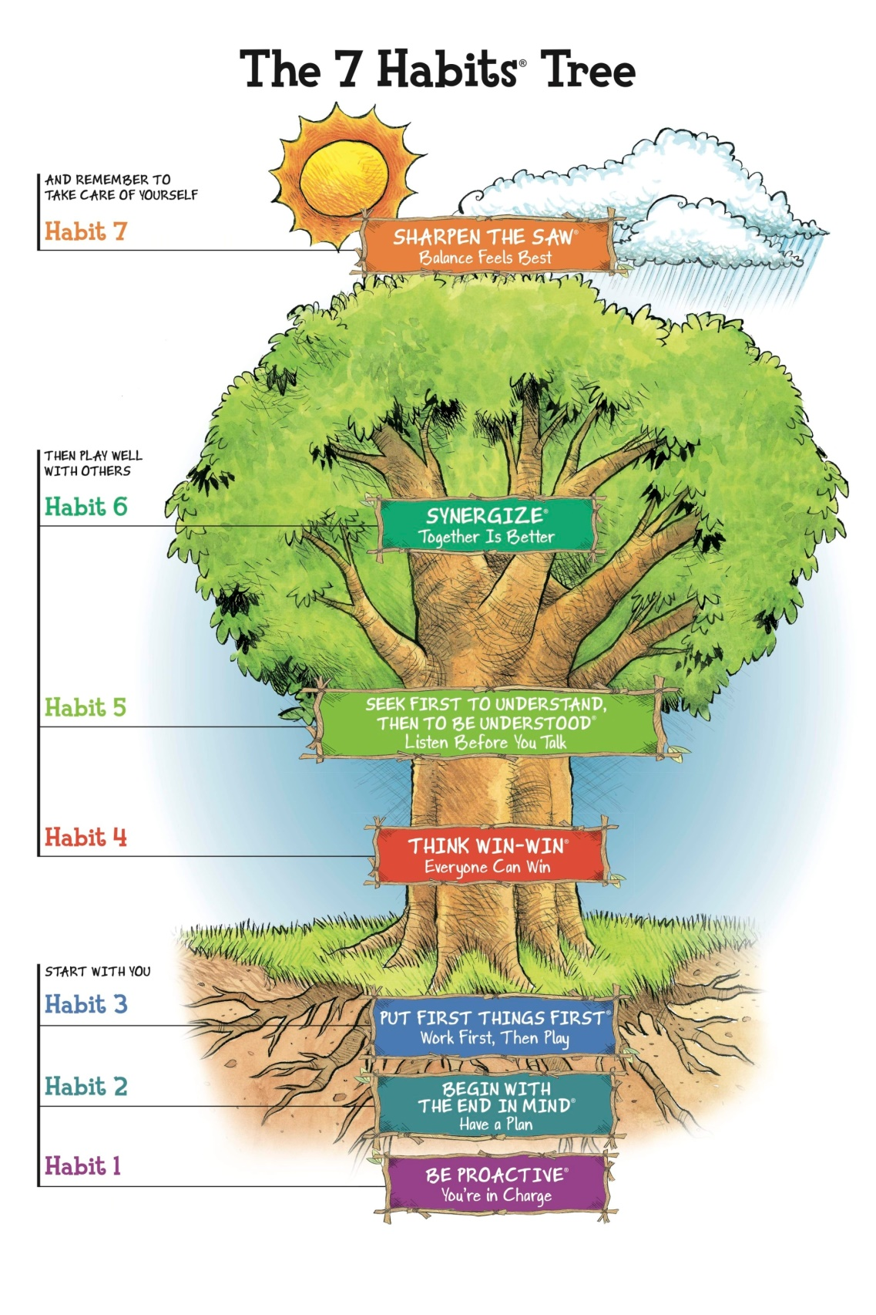

Slide 5
What exactly are habits?
Habits are things we do repeatedly
Most of the time we are hardly aware we are doing them
We are simply on autopilot

Slide 6
What can the 7 Habits do for you?
Get control of your life
Improve your relationships with your friends
Make smarter decisions
Get along with your parents
Overcome addiction
Define your values and what matters most to you
Increase your self-confidence
Be happy
Find balance between school, work, friends, and everything else!

Slide 7
Paradigms and Principles
Career Life Education 10

Slide 8
Top 10 All-Time Stupid Quotes
Read along with your handout!
Watch Subaru Commercial
https://www.youtube.com/user/SubaruCanada

Slide 9
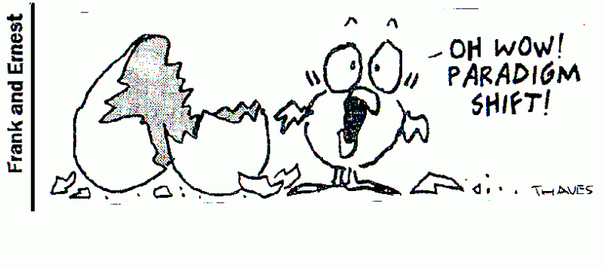
What’s a paradigm?
Another word for perception
The way you see something
Your point of view
Your frame of reference
Your beliefs

Slide 10
Paradigms are like glasses
An incomplete view about yourself or life in general – is like wearing glasses with the wrong prescription
The lens affects how you see everything
The right prescription will cast a rosy hue on everything you do

Slide 11
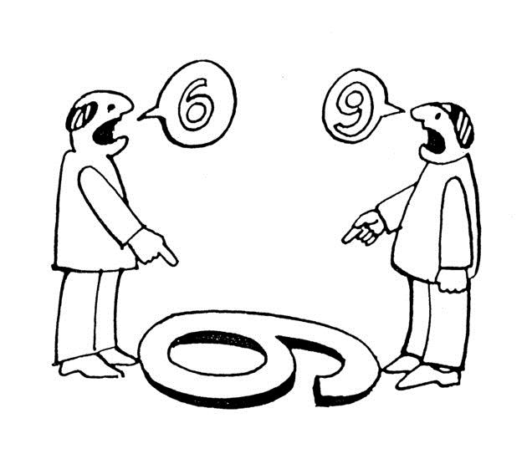

Slide 12
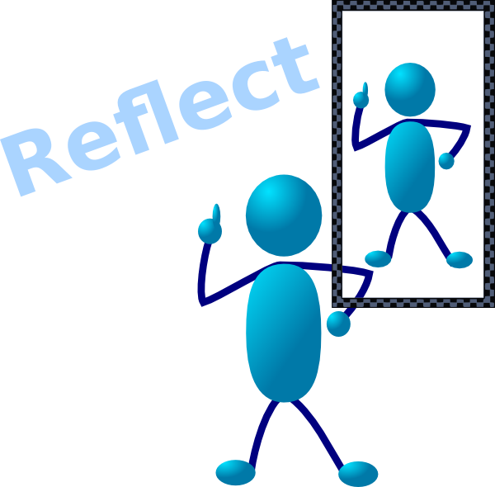
Paradigms of Self
Negative self-paradigms can put limitations on us
Positive self-paradigms can bring out the best in us
Ask yourself, are your self-paradigms helping or hindering you?
Ms. D will read examples from book

Slide 13
Paradigms of Self
If you walk through life wearing glasses that say “I can do it” or “I matter,” that belief will put a positive spin on everything else.

Slide 14
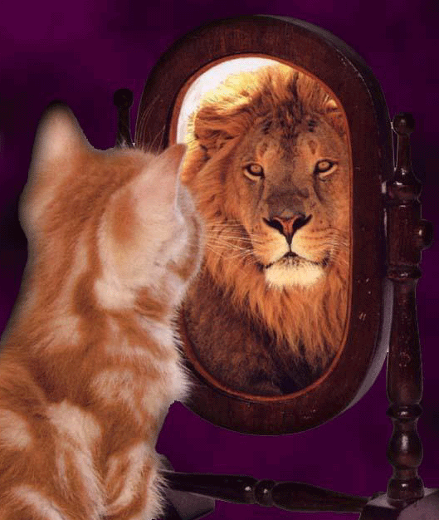
How do you fix your self-paradigm?
One way is to spend tie with someone who believes in you and builds you up.
Ask any successful person and most will tell you that they had a person who believed in them…
A teacher/mentor
A friend
A parent/guardian
A sister/brother/grandmother

Slide 15
Paradigms of Others
We not only have paradigms about ourselves, but about others too.
Seeing things from a different point of view can help us understand why other people act the way they do.
Ms. D. will read examples from p 16 - 18

Slide 16
Paradigms of others
Our paradigms of others are often incomplete, inaccurate, or completely messed up.
We shouldn’t be so quick to judge, label or form rigid opinions of others.
From a limited point of view, we seldom see the whole picture, or have all the facts.
We should open our minds and hearts to new information, ideas, and points of view, and be willing to change our paradigms when it becomes apparent they are wrong.

Slide 17
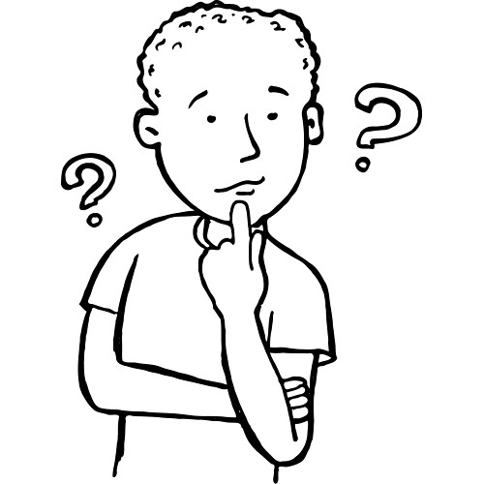
Paradigms of Life
You can usually tell what your life paradigm is, if you ask yourself
“What do I spend my time thinking about?”
“Who or what is my obsession?”
Whatever is most important to you will be come your paradigm or life-center

Slide 18
Paradigms of Life
Friends
Stuff
Boyfriend/Girlfriend
School
Parents
Sports
Hobbies
Heroes
Enemies
Self
Work
These each have their good points, but they are all incomplete in one way or another and they’ll mess you up if you center your life on them.

Slide 19
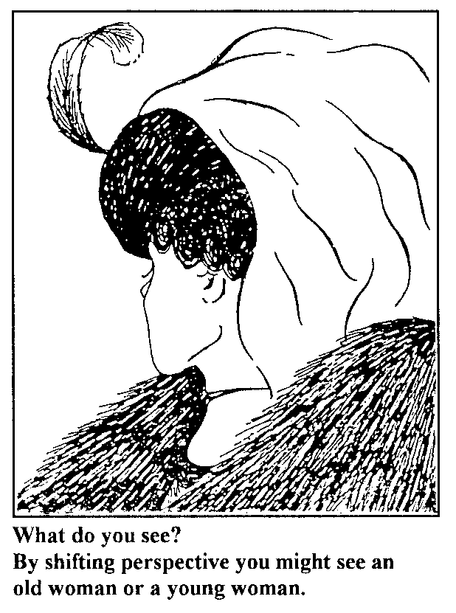

Slide 20
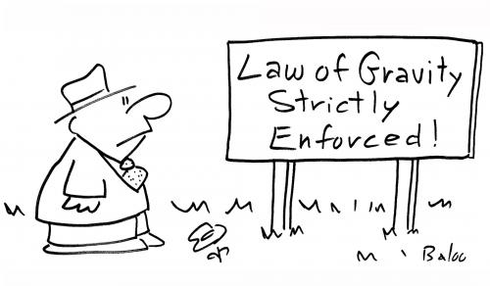
Principle Centered The Real Thing
Just as there are natural laws in the physical world – there are laws (or principles) in the human world.
They apply to everyone, rich, poor, king, peasant, male, female, or other
If you break them you will fail
If you live by them you will succeed

Slide 21
Principles to Live By
Honesty
Service
Love
Hard work
Respect
Gratitude
Moderation
Fairness
Integrity
Loyalty
Responsibility

Slide 22
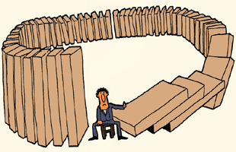
Principles to Live By
It takes faith to live by principles.
Especially when you see people close to you get ahead in life by lying, cheating, indulging, manipulating, and serving only themselves.
What those people don’t see, is that breaking principles always catches up to them in the end (karma?).

Slide 23
Principles
School
Work
Stuff
Sports
Hobbies
Parents
Hero/Enemy
Self
Boyfriend
Girlfriend
Friends

