Slide 1
Core Competencies
Notes:
What are core competencies? Ask class then answer.

Slide 2
What are your strengths?

Slide 3
Core Competencies
sets of intellectual, personal, and social and emotional
develop in order to engage in deep learning and life-long learning.
Ultimate goal is is to employ the core competencies every day in school and in life
What are they?

Slide 4
There are 3 Core Competencies!
Communication
Thinking
Personal & Social
Notes:
What are they?

Slide 5
Communication

Slide 6
Communication
impart and exchange information, experiences, and ideas
explore the world around them
understand and effectively engage in the use of digital media.

Slide 7
Communication
Connect and engage with others (to share and develop ideas)
Inquire, interpret, and present information (includes inquiries)
Collaborate to plan, carry out, and review constructions and activities
Explain/recount and reflect on experiences and accomplishments

Slide 8
Thinking

Slide 9
Thinking
→ Creative Thinking
→ Critical Thinking

Slide 10
Creative Thinking
generation of new ideas and concepts that have value to the individual or others
development of these ideas and concepts from thought to reality.
Thinking

Slide 11
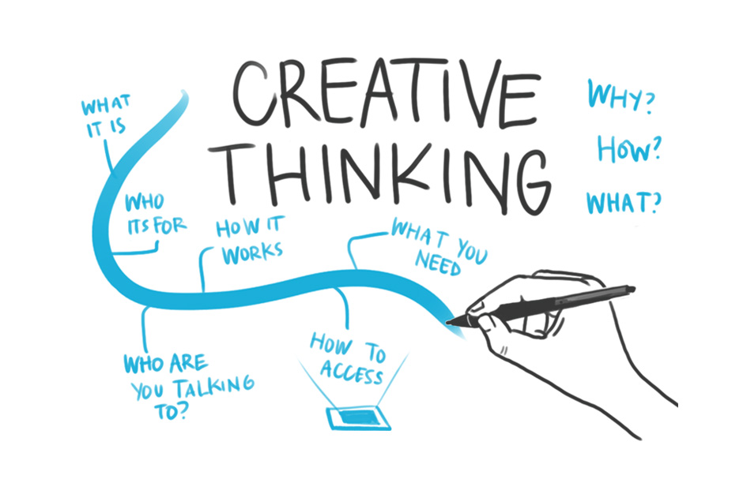
Creative Thinking
Novelty & Value
Generating Ideas
Developing Ideas

Slide 12
Critical Thinking
making judgments based on reasoning
analyze these using specific criteria and draw conclusions and make judgments.
examine their own thinking, and that of others, about information that they receive through observation, experience, and various forms of communication.
Thinking

Slide 13
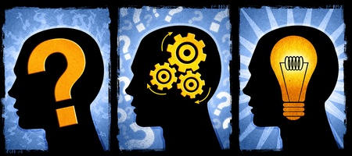
Critical Thinking
Analyze & Critique
Question & Investigate
Develop & Design

Slide 15
Personal & Social
Notes:
SEL

Slide 16
Personal & Social
→ Positive Personal & Cultural Identity
→ Personal Awareness & Responsibility
→ Social Responsability

Slide 17
Positive Personal & Cultural Identity
awareness, understanding, and appreciation of all the facets that contribute to a healthy sense of oneself
awareness and understanding of one’s family background, heritage(s), language(s), beliefs, and perspectives in a pluralistic society.
contribute to their own well-being and to the well-being of their family, community, and society.
Personal & Social

Slide 18
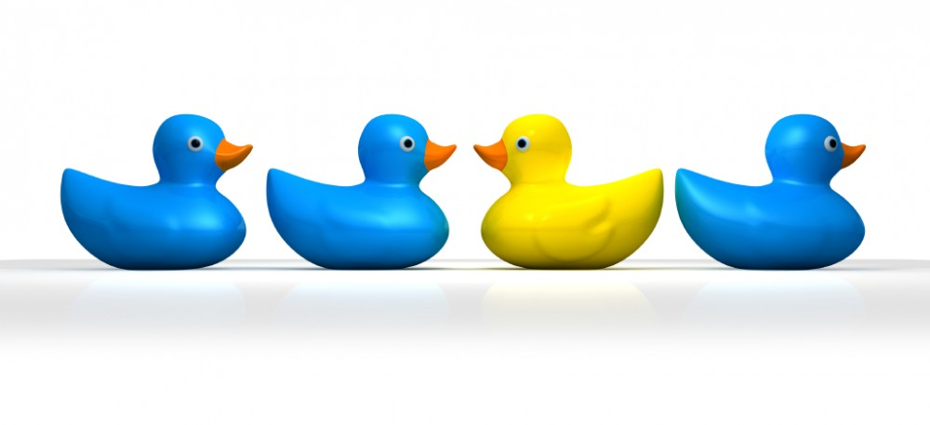
Positive Personal & Cultural Identity
Relationships & Cultural Contexts
Personal Values & Choices
Personal Strengths & Abilities

Slide 19
Personal Awareness & Responsibility
skills, strategies, and dispositions that help students to stay healthy and active, set goals, monitor progress, regulate emotions, respect their own rights and the rights of others, manage stress, and persevere in difficult situations.
Personal & Social

Slide 20
Positive Awareness & Responsibility
Self-determination
Self-regulation
Well-being

Slide 21
Social Responsibility
consider the interdependence of people with each other and the natural environment
contribute positively to one’s family, community, society, and the environment
resolve problems peacefully
empathize with others and appreciate their perspectives
create and maintain healthy relationships.
Personal & Social

Slide 22
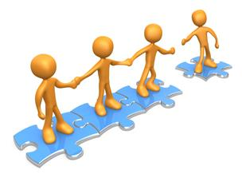
Social Responsibility
Contributing to the community and caring for the environment
Solving problems in peaceful ways
Valuing diversity
Building Relationships

Slide 23
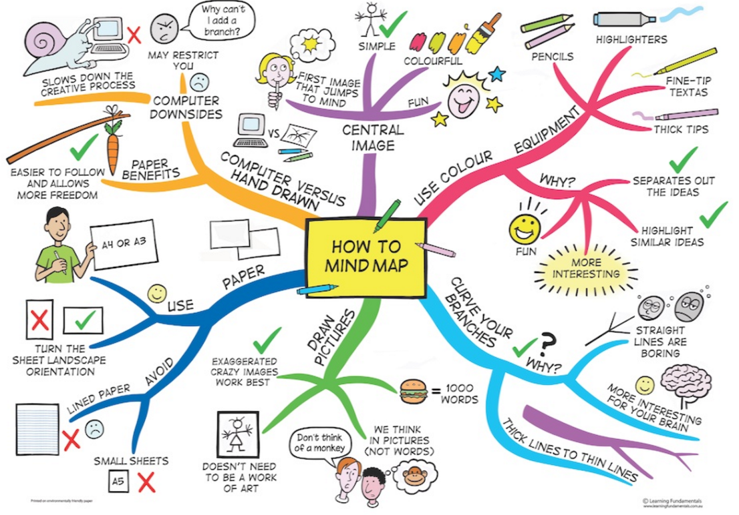

Slide 24
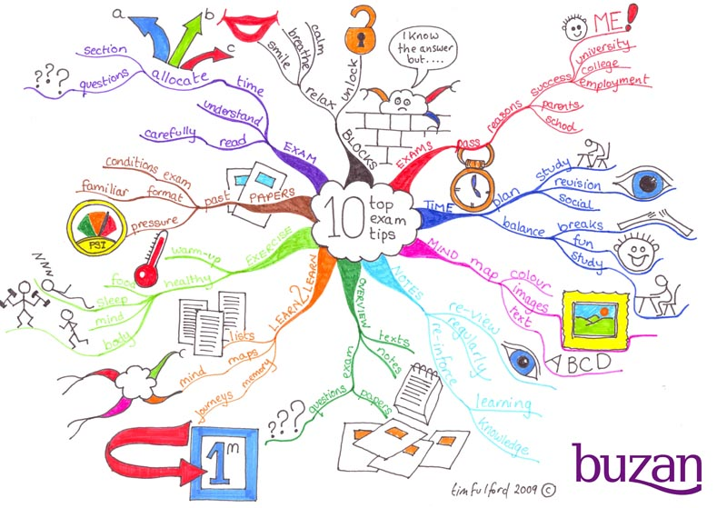

Slide 25
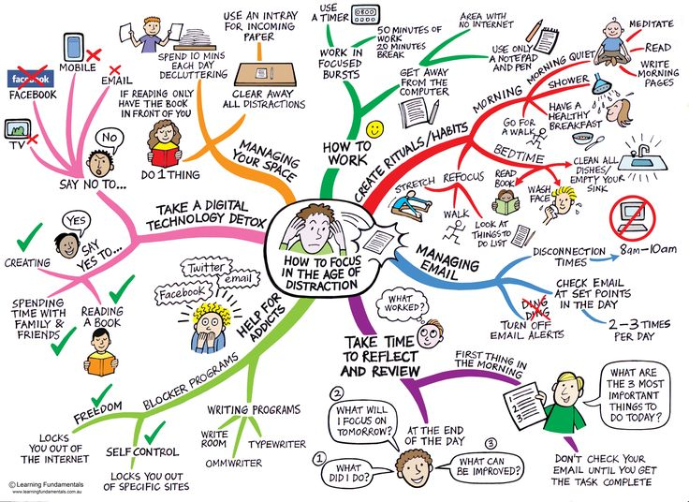

Slide 26
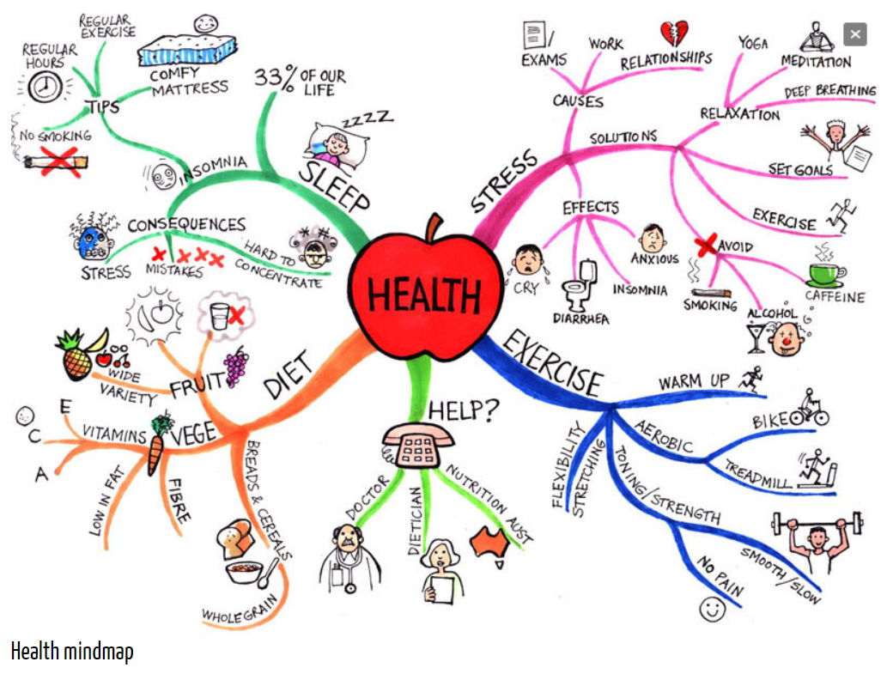

Slide 27
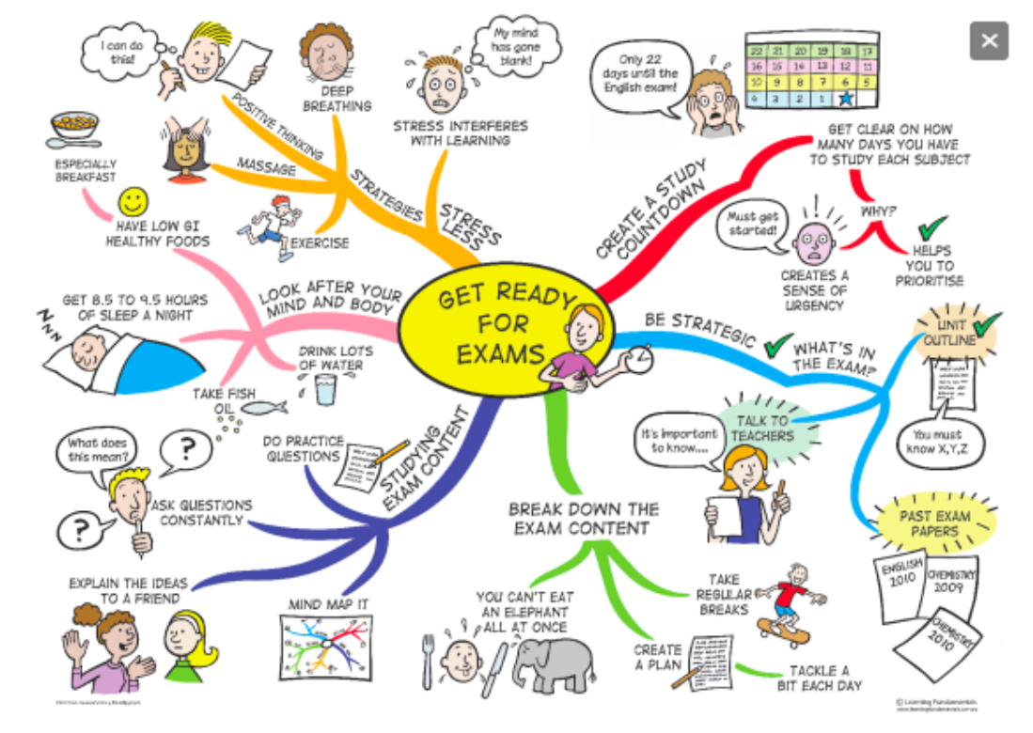

Slide 28
