Slide 1
Career Life Education 10

Slide 3
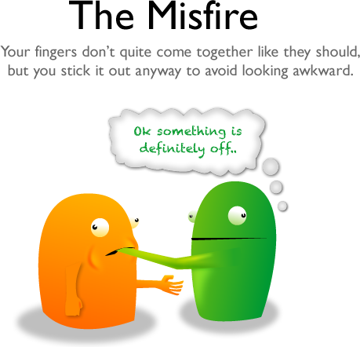

Slide 4
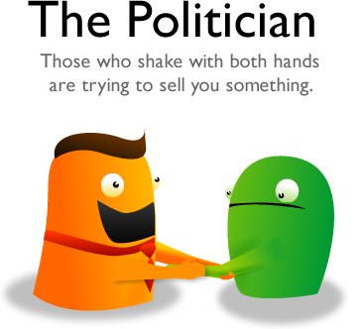

Slide 8
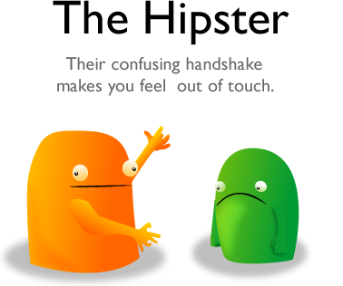

Slide 9
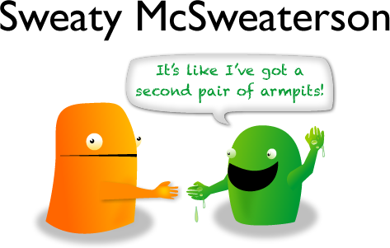

Slide 11
So, how are you supposed to shake hands?

Slide 12
Tips For A Proper Handshake
Stand and look the person in the eye
If you are sitting, rise before extending your hand
Make eye contact and offer a sincere smile to show that you are happy to be where you are
Be still and face the other person to prevent giving the impression that you are in a hurry to get away.

Slide 13
Tips For A Proper Handshake
Offer a friendly greeting as you shake hands
Your greeting should include his or her name and a pleasantry, such as, “It’s so nice to meet you, Ms. Jones.”

Slide 14
Tips For A Proper Handshake
Your handshake should be firm, not crushing or limp
A limp handshake give the impression of weakness
Be firm, but not overpowering
If the other person offers a limp hand, give a gentle squeeze

Slide 15
Tips For A Proper Handshake
The handshake should be approximately two to five seconds long
Most people prefer shorter handshakes
Be observant and follow the lead of the other person, particularly if he or she is in a superior position to you (interviewer)
If the other person continues holding onto your hand longer than five seconds, politely withdraw your hand – maintain eye contact and a pleasant expression afterward to maintain a positive interaction.

Slide 16
Tips For A Proper Handshake
Be aware of your other hand
Most people use their right hands unless they have a reason to use the left.
Ideally, your left hand should be visible and unclenched.
Don’t have your free hand in your pocket.
In a business setting you also shouldn’t use your left hand to touch the other person’s arm or cup his or her hand (this is only ok in a personal setting).

Slide 17
Tips For A Proper Handshake
Shake hands up and down
Don’t go back and forth
Don’t pump the other person’s hand more than three times

Slide 18
Let’s Practice!

