Slide 1
Core Competencies

Slide 2
What Are They?
Communication Thinking Personal & Social
Creative
Critical
Positive Personal & Cultural Identity
Personal Awareness and Responsibility
Social Responsibility

Slide 3
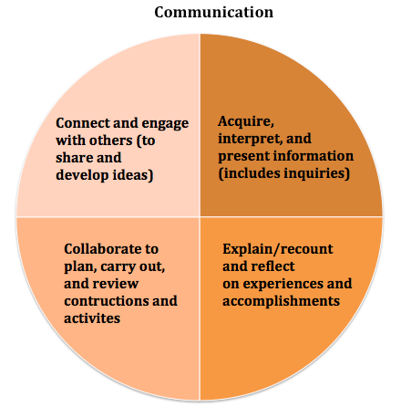
Communication
How do you share information?
How do you demonstrate active listening and contribute to collaborative work environment?
What do you do when you disagree?
How do you adapt when communicating to different audiences?

Slide 4
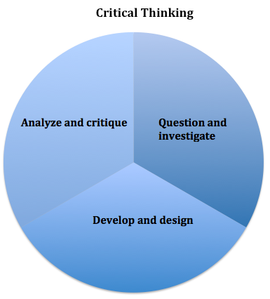
Critical Thinking
What things do you consider when making a decision?
Describe something that didn’t work and what you did differently?
What strategies do you use to analyze ideas?
Describe a time when you changed your mind and why.

Slide 5
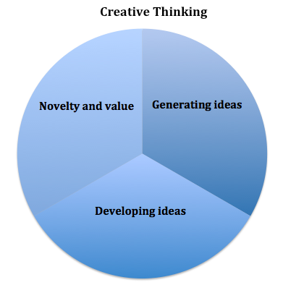
Creative Thinking
Where do your new ideas come from?
How do you use other people’s ideas to support your thinking?
What inspires you to be creative?

Slide 6
Personal & Social
What strategies do you use to persevere?
How do you look for ways to make the lives of others better?
What influences your decisions?
Positive Personal & Cultural Identity
Personal Awareness and Responsibility
Social Responsibility

Slide 7
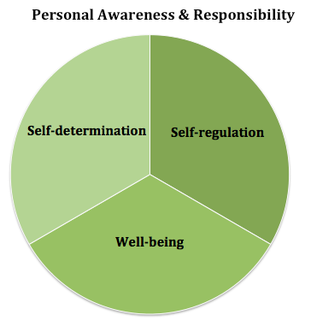
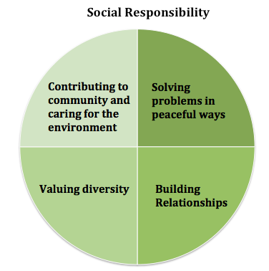
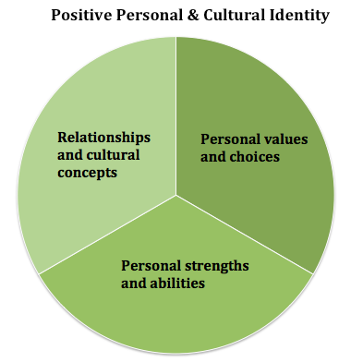

Slide 8
Video Examples Demonstrating the Core Competencies
Christian – Laser Flip
https://www.youtube.com/watch?v=S9KE2R92pSg&t=11s&list=PL7Xq1zk0ZBvkHYvnmlvk0sa3XYosjyWnf&index=5
Kid President – 20 Things We Should Say More Often
https://www.youtube.com/watch?v=m5yCOSHeYn4&index=2&list=PL7Xq1zk0ZBvkHYvnmlvk0sa3XYosjyWnf

Slide 9
Matching Scenarios
Our teacher in Socials shared with the class an Okanagan First Nations story called “How Names Were Given.” Students were then asked to consider how their names were chosen.
During a class on Sustainability, a student decides they want to rescue trees and takes the initiative to extend their class project.
Notes:
Positive Personal & Cultural Identity
Social Responsibility

Slide 10
Matching Scenarios
3. Students in English class were asked to write group poem of their choice and then to reflect on the final product.
4. Students in a French class wrote a personal biography of their family and friends with pictures, then presented it in French.
Notes:
3. Creative Thinking
4. Communication

Slide 11
Matching Scenarios
5. In Career Life Education, students reflected on their progress so far, set goals, and created a plan for future improvement.
6. Students chose a current scientific topic or problem. Then created documentaries that explored the pros and cons of the issue, plus considered the various stakeholders.
Notes:
5. Personal Awareness & Responsibility
6. Critical Thinking

Slide 12
Did you match all six?

Slide 13
Reflect and Self-Assess
At the end of the semester/year all students will have to reflect on and self-assess their development in the core competencies.
As it is a good habit to develop, we will be practicing reflecting and self-assessing throughout the semester.

Slide 14
Let’s Practice
Reflect on your COMMUNICATION skills
Think about your experiences during the school year so far.
How do you communicate? Provide an “I” statement
What example(s) can you give that demonstrate your ability to communicate? Provide evidence or an artifact.
How do you feel you could grow in communication? Provide your future growth plan.

Slide 15
Ms. Duffield’s example
I can communicate clearly and share my ideas. I am confident when speaking to different audiences.
An example where I have demonstrated this was when I had to give a speech at a Toastmaster’s club meeting. I was able to give my speech confidently, I spoke clearly, and I didn’t have to rely on cue cards.
Artifact: A copy of my speech
I can improve my communication skills by continuing to practice speaking to a variety of audiences and challenge myself to speak in front of larger audiences of peers, such as at a professional development conference.

