Slide 1
Entrepreneurial Thinking
CLE 10

Slide 2
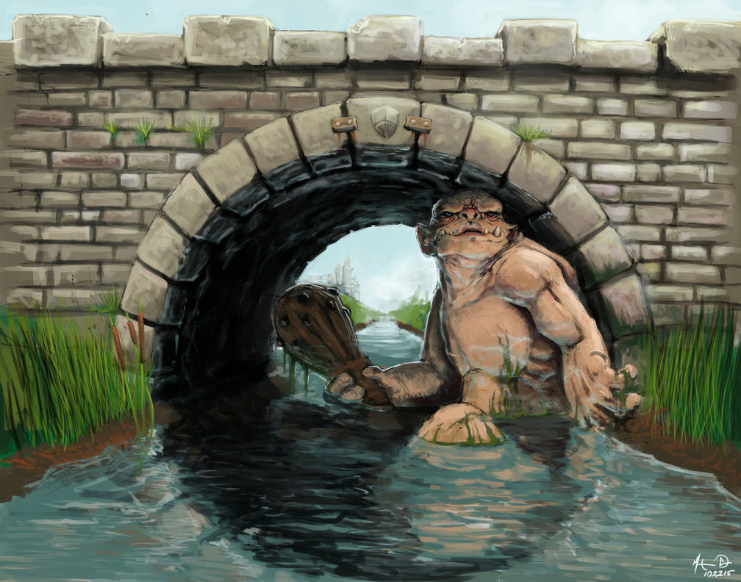
Q. On your way home one day you come across a bridge guarded by a great beast. What do you do?
Think / Pair / Share

Slide 3
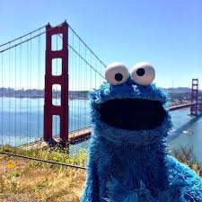
What options get you home fastest? What options are riskiest?
Fight the beast
Trick the beast
Distract the beast
Turn around and leave
Scare the beast
Outrun the beast
Come back with backup
Wait until the beast falls asleep
Try to find another way home
Bribe the beast

Slide 4
The Billy Goats Gruff
https://www.youtube.com/watch?v=aiy3a1v9Q2E

Slide 5
Entrepreneur
Definition:
the owner or manager of a business enterprise who, by risk and initiative, attempts to make profits

Slide 6
Dragon’s Den
Successful:
http://www.cbc.ca/dragonsden/pitches/traptap
Unsuccessful:
https://www.youtube.com/watch?v=SBmkrwu9wzk

Slide 7
Brainstorm
What traits make a successful entrepreneur?
How did the people in the unsuccessful Dragon’s Den clip show entrepreneurial thinking?

Slide 8
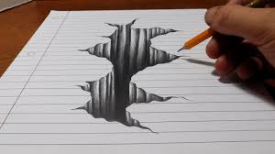
Activity:
Draw a bicycle with no pictures to help. Write down what you’re thinking as you do this on the right side of your paper.

Slide 9
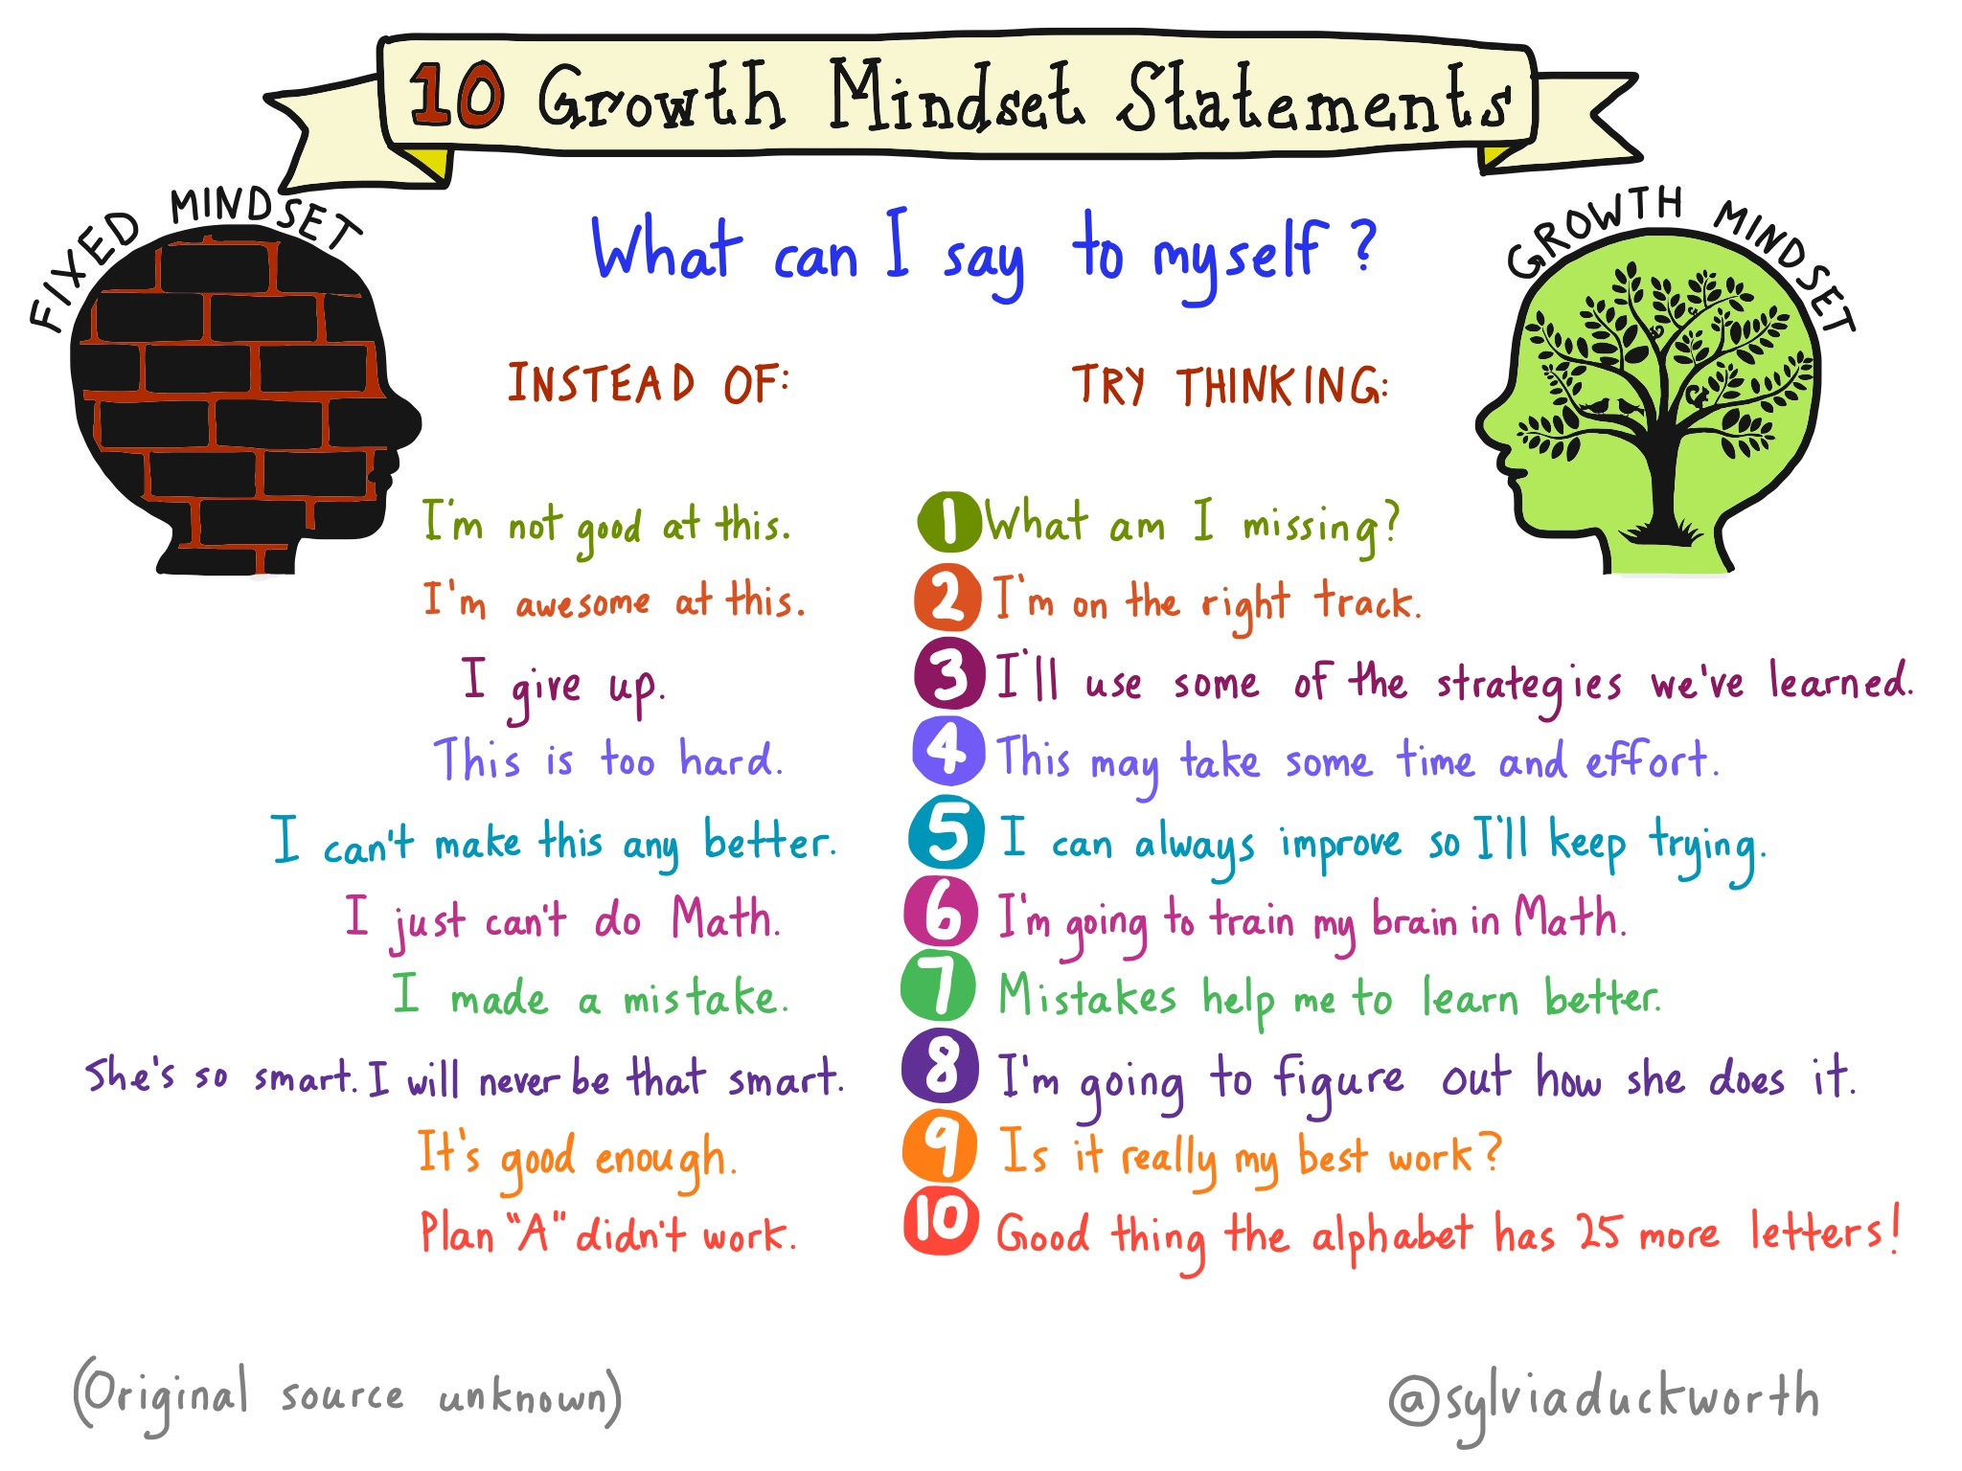

Slide 10
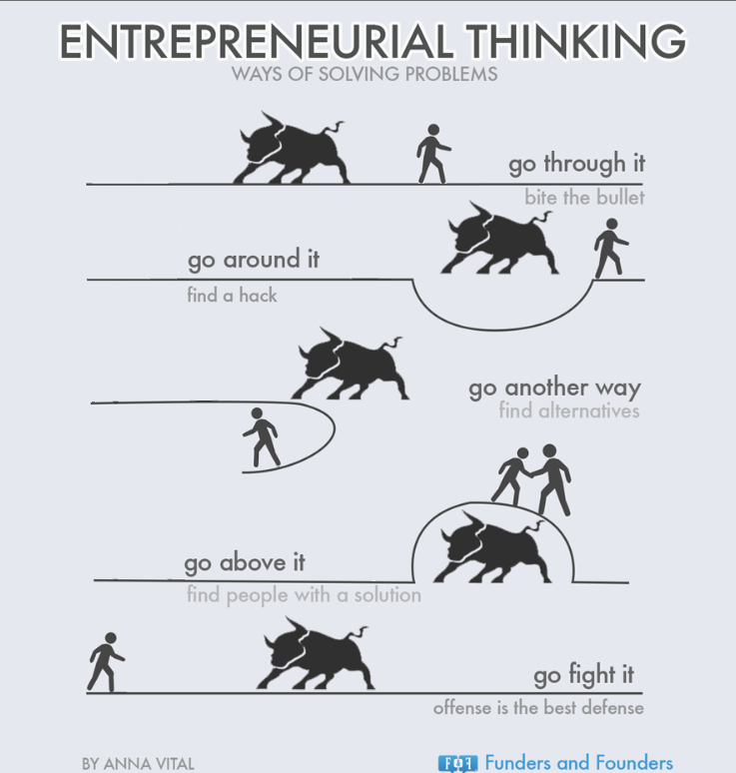
Takeaway for today:
1. An entrepreneur doesn’t give up, they find creative ways around problems.

Slide 11
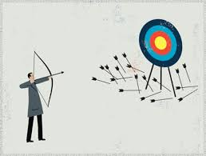
2. An entrepreneur doesn’t blame others for failures or make excuses, they accept responsibility for their part and look towards a solution.

Slide 12
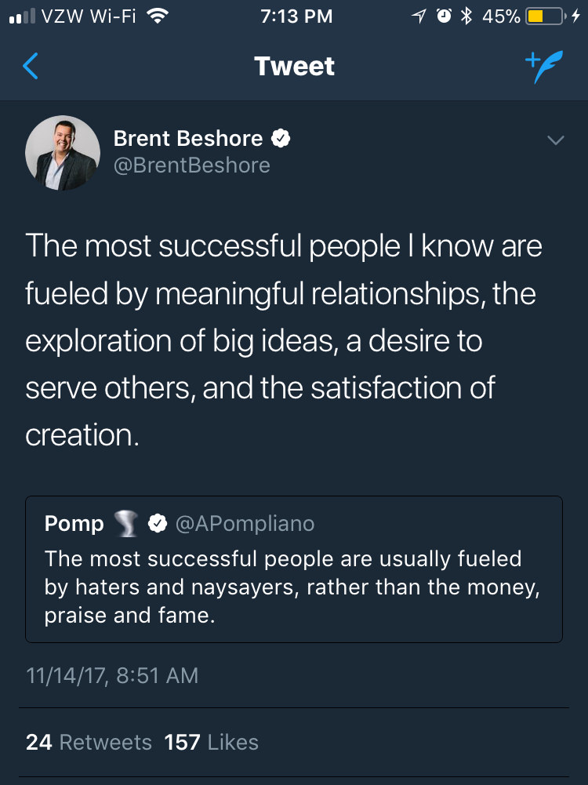
3. An entrepreneur doesn’t have “haters” An entrepreneur empowers others, not alienate, criticize, or compete with them.

Slide 13
Additional Video
I made a movie. It stunk. - Austin McConnell. (30:45)
https://www.youtube.com/watch?v=ivfspJOAtBI&t=29s

Slide 14
Everyday Obstacles
What are some goals, problems, or obstacles that we encounter in our everyday lives where we can use entrepreneurial thinking?
Think / Pair / Share

Slide 15
Ticket out the door:
Explain a goal you were trying to achieve last semester, what obstacles came in front of it, and what you did to overcome them (or try).
Example:
“I tried to get perfect attendance last semester. An obstacle to that was my brother making me late to school when getting rides with my mom. I overcame this and took control of my timing by starting to bike to school. “

