Slide 1
Equality vs. Equity
What you need in the workplace.

Slide 2
What’s the difference between equality & equity?
Equality: “the state of being equal”
Every person gets the same thing.
E.g. opportunities, burdens, expectations, treatment.

Slide 3
Sometimes equality is necessary
Examples:
Equal hiring policies
Equal pay and promotions for equal performance
Equal treatment and opportunities by employers
Not being treated differently based on race, gender, sexual orientation, age

Slide 4
Question:
Is it fair to have the same expectations for everyone?
Is it fair to treat everyone like they’re the same?

Slide 5
What’s the difference between equality & equity?
Equity: “the state of being fair”
Every person’s needs are evaluated for equal outcomes.
E.g. opportunities, burdens, expectations, treatment.

Slide 6
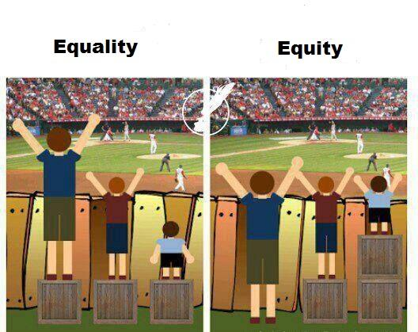

Slide 7
In other words…
Equality:
equal treatment
Equity:
equal outcomes

Slide 8
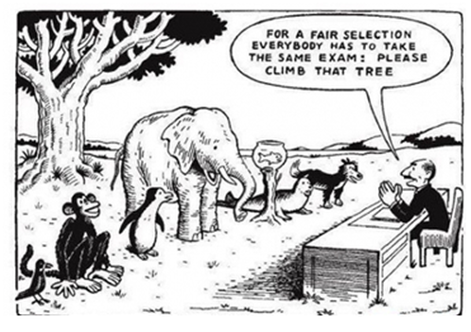

Slide 9
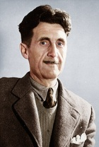
“All animals are equal, but some animals are more equal than others.”
George Orwell, Animal Farm.
Does this quote make sense?
How can we use this quote to talk about society?

Slide 10
Discuss / think-pair-share:
What are some examples of people that may need special considerations to create workplace equity?
How can employers accommodate them?

Slide 11
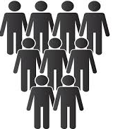
Which is better for a company?

Slide 12
Preferential Hiring Policies
Some institutions have preferential hiring policies to solve issues of equity.
Preferred applicants include:
Aboriginal Peoples
People with disabilities
People who are a visible minority
Women

Slide 13
The myth of the “best man for the job”

Slide 14
Why preferential hiring?
Some companies and institutions take measures to hire people from diverse backgrounds and walks of life. This benefits the institution by:
- More evenly representing the population base they serve
Spreading diversity in the workplace culture
Seeks to offset the social inequality people are born into

Slide 15
Is a workplace losing out by not hiring the “best candidate”?
Think/pair/share: choose the best candidate for an entry level office position:
Candidate #2
Young male
Bachelor’s degree with honors
3 years experience
Has a learning disability
Candidate # 1
Single mother of 2 young children
10 years experience in field
Bachelor’s degree
2 years experience in management
Has a chronic illness
Candidate # 3
Young female minority
Master’s degree
0 years experience

Slide 16
Types of attributes a job may demand:
Empathy
Works quickly & efficiently
Presentation skills
Creativity
Work in a team
Management skills
Open availability
Work long hours
Attention to detail
Strong social skills
Problem Solving
Competence with technology
Good with numbers

Slide 17
Many jobs will have more qualified candidates than positions, and one single job requires many different skills and attributes, which different people have different combinations of.
Takeaway

