Slide 1
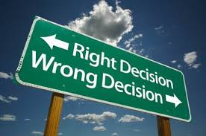
Ethical Behaviour

Slide 2
Ethical Behaviour
Definition:
“rules of behavior based on ideas about what is morally good and bad”
-Who makes the rules?

Slide 3
What are ethics in the workplace?
Being kind and respectful to all
Not putting others down
Being trustworthy
Not stealing money or items from work
Not giving workplace goods to friends
Practicing confidentiality
Not gossiping, resolving issues head-on
Being accountable
Not blaming others

Slide 4
When can we forget about ethics?
When we start thinking the company we work for “owes us something”.
When we are distressed, depressed or angry.
When there is a ruthless or close-minded workplace environment.
When the line is blurred between coworker and friend.

Slide 5
Sexual Harassment and Assault
In the wave of sexual assault allegations in 2017 and the “me too” movement, society has finally started to take women’s voices on the matter seriously.

Slide 6
Sexual Harassment and Assault
Harassment:
Sexual harassment is bullying or coercion of a sexual nature, or the unwelcome or inappropriate promise of rewards in exchange for sexual favors.
Assault
Sexual assault is a sexual act in which a person is coerced or physically forced to engage against their will, or non-consensual sexual touching of a person.

Slide 7
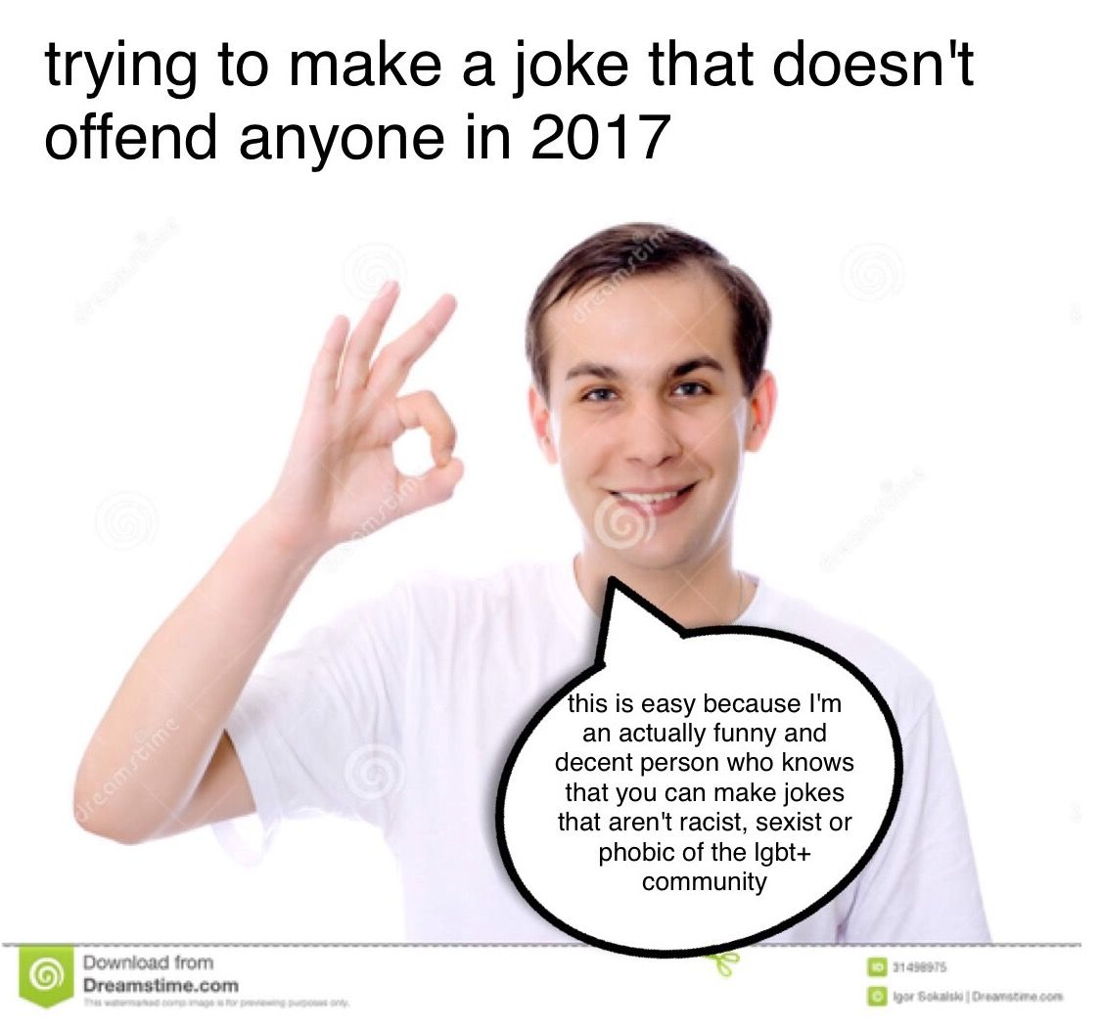
When is it a joke and when is it harassment?
It’s not a good joke when…
It puts down others
It is sexual in nature
It targets a certain group in society
It relies on stereotypes

Slide 8
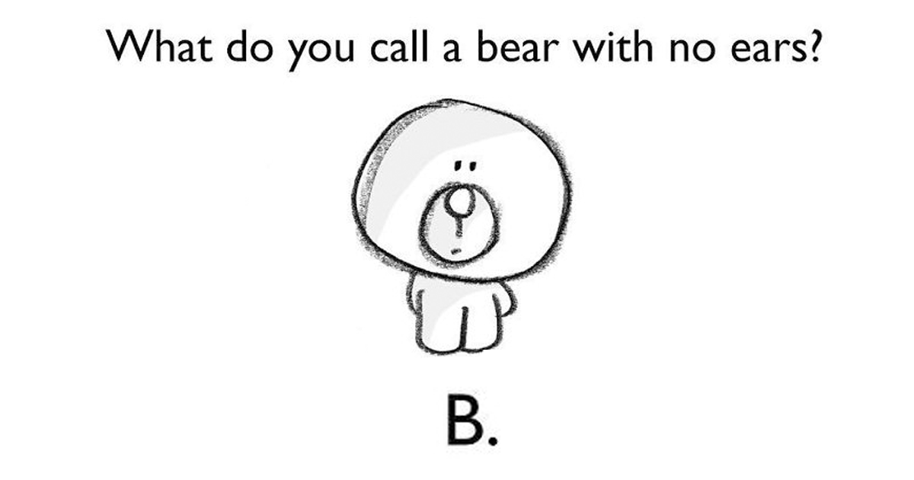
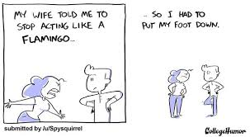
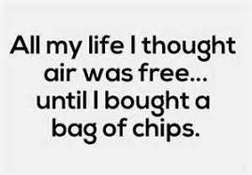
Free non-offensive jokes...

Slide 9
When does a woman deserve the sexual attention?

Slide 10
Sexual Harassment Videos
Warning: These videos contain suggestive content and are very uncomfortable.
“That’s Harassment”
https://www.theguardian.com/world/video/2017/apr/12/thats-harassment-david-schwimmer-and-sigal-avin-tackle-sexual-harassment-video

Slide 11
Takeaway...
You should NEVER bring up sexual topics or talk about someone’s body in the workplace. It is not the appropriate time nor place.
Golden rule: If you wouldn’t say it around a teacher or principal, don’t say it in the workplace.

