Slide 1
Interests (Holland’s Personatlity Survey)
CLE 10

Slide 2
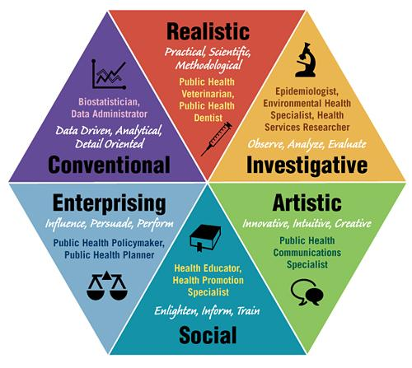
American psychologist John L. Holland came up with the theory that people possess one of six types of personalities:
Artistic – “Creators”
Social – “Helpers”
Conventional – “Organizers”
Investigative – “Thinkers”
Realistic – “Do-ers”
Enterprising – “Persuaders”

Slide 3
Think / Pair / Share
Would you rather work at a job you disliked for 25% more money, or a job you really liked for 25% less money?

Slide 4
Some people prefer their job just to be a job, and pursue interests outside work.
Some people prefer to have a rewarding career they are passionate about.
* Pursuing a passion doesn’t always mean less $$!

Slide 5
Understanding interests can help us discover jobs that we might be good at or passionate about.

Slide 6
Artistic (A) “The Creator”
Artistic occupations require self-expression, creativity and usually feature work that can be done without following a clear set of rules.
These occupations usually require an environment where flexibility, variety and change are expected.
Likes creative activities like art, drama, crafts, dance music or creative writing.
Generally avoids highly ordered or repetitive activities.
Sees self as expressive, original and independent.

Slide 7
Social (S) “Helper”
Social occupations revolve around people. These occupations usually involve assisting, teaching, healing or serving others.
The focus of Social occupations can range from very practical to highly academic outcomes.
May be interested in teaching, nursing, giving first aid, providing information, counseling and solving social problems.
Generally avoids using machines or tools to achieve a goal.
Seen as helpful, friendly and trustworthy.

Slide 8
Conventional (C) “Organizer”
Conventional occupations focus on information and the tools required to analyze, organize and understand information.
They also include activities such as creating plans, processes and routines.
These occupations usually provide an environment where things are well organized and roles and tasks are clearly define.
Likes to work with numbers, records, or machines in a set, orderly way.
Generally avoids ambiguous, unstructured activities.
Sees self as orderly and good at following a set plan.

Slide 9
Investigative (I) “Thinker”
Investigative occupations involve working with theories, concepts, information and ideas.
Curiosity, reasoning, logic, research, analysis, and science are typical activities in investigative occupations.
Likes to study and solve math or science problems.
Generally avoids leading, selling, or persuading people.
Sees self as precise, scientific and intellectual.

Slide 10
Realistic (R) “Do-er”
Realistic occupations involve practical, hands-on activities.
They focus on working with plants, animals, materials, tools and machines.
Many realistic occupations require working outdoors
Realistic occupations do not involve a lot of paperwork or working closely with others; generally avoids social activities like teaching, healing and informing others.
Sees self as practical, mechanical, and realistic.

Slide 11
Enterprising (E) “Persuader”
Enterprising occupations frequently involve starting and carrying out projects.
These occupations can involve leadership and management skills and the willingness to take risks.
Generally avoids activities that require careful observation and scientific thinking
Values politics, leadership, business and selling things or ideas
Sees self as energetic, ambitious and sociable

Slide 13
Investigative
Artistic
Realistic
Enterprising
Conventional
Social

