Slide 1
Income
Ways to Make Money $

Slide 2
Ways to Earn Money
Fixed = does not change. Always the same
Variable = Varies. May change. Not always guaranteed.

Slide 3
Salary
A regular fixed payment for work. Usually expressed as an amount per year but paid regularly (eg. Semi-monthly or bi-weekly)
Notes:
Teachers, Engineers, …

Slide 4
Hourly Wage
A fixed payment for each hour or work
Example: 12.65 per hour
Notes:
Restaurant industry, some retail.

Slide 5
Self- Employed
A person who works for himself or herself.
Notes:
Business owner, hairdresser, trades

Slide 6
Piecework
When you are paid according to the number of items you produce.
Agriculture
Craftwork, artisans
Writing, editing
Cable Installation
Truck Driving
Notes:
Harvesting… get paid by the pound.

Slide 7
Commission
A payment based on a percentage of the worker’s sales.
Stockbroker
Real Estate Agents
Care salesmen
Loan officer

Slide 8
Contract
A payment for a fixed period of time or a fixed amount of money for a specific amount of work.
Construction
Landscaping
Notes:
Builders - get a job (a contract) to construct a building. When that ends their job ends.

Slide 9
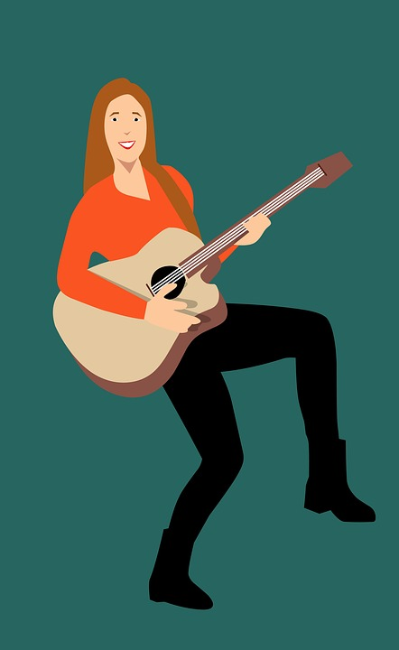
Royalties
A payment for a piece of work that is marketed and sold.
Notes:
Musician, artist,

Slide 10
Tip
Money paid for a service
Notes:
Restaurant industry, hairdresser, concierge at hotels, taxi drivers, uber drivers

Slide 11
Apprenticeship
Apprentices get paid to work while they train with a skilled trades worker.
Electricians
Plumbers
Carpenters
Hairdressers
Drafting

Slide 12
Other sources of income
Contributions from parents or other relatives
Your savings and other assets
Scholarships, bursaries and grants

Slide 13
THINK - PAIR - SHARE
What are reasonable ways that YOU can earn money?
Notes:
Use the Resume you created in class to start getting work experience.

Slide 14
Easy Ways To Make Money According to Forbes
Drive Uber or Lyft
Become a market research participant
Sell old books on Amazon
Sell things on Craiglist
Do tasks with TaskRabbit
Deliver for PostMates
Sell on CafePress or Etsy
Tutoring
Answer questions on JustAnswer or sites like it
Do gigs on Fivver
Walk dogs
Babysit

