Slide 1
Job Interview
Career Life Education 10

Slide 2
Dress the Part
Pages 7-8 in your handout

Slide 3
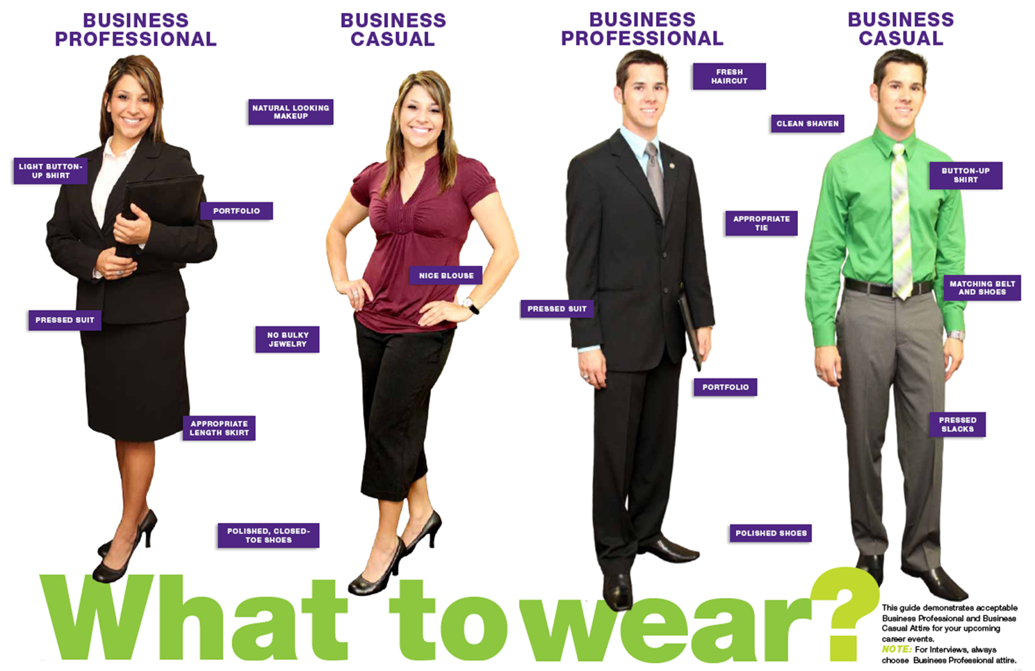

Slide 4
Men
A suit and tie (if applicable); A well-fitted, well-styled suit makes you look successful.
You could also wear dress pants, a solid coloured sweater with a collared shirt underneath.
Wear dress shoes – polished and in good condition. No athletic foot-wear, runners, skate shoes, etc.
The colour of your socks should complement your pants and shoes.

Slide 5
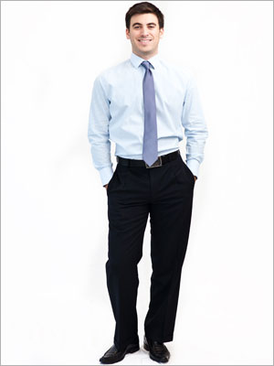
Men
A solid coloured shirt. When in doubt, wear white. A tee-shirt underneath helps prevent noticeable perspiration.
If wearing a tie, make sure it is of conservative colour/pattern.
Easy on accessories - flashy watches, attention-grabbing eye glass, or other jewelry.

Slide 7
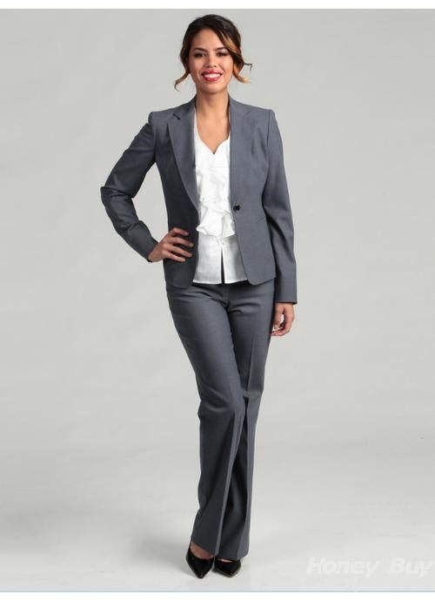
Women
A suit with a skirt or dress pants is the standard interview outfit.
Shirt should be conservative style, colour, and fabric.
Covered shoulders, a tailored jacket or cardigan may be worn.
Skirt length just above the knee (nothing shorter).

Slide 8
Women
Do not wear anything too tight, revealing or sloppy.
Polish those dress shoes, no overly high heels, no open toes.
Wear minimal jewelry, avoid jangly bracelets, wear small earrings.
Natural looking makeup.

Slide 10
Dress the Part con’t
Be conservative with accessories like a purse or briefcase.
In most business settings, a backpack looks silly with a suit, so carry your résumés in a portfolio.
Make sure you shower or bath beforehand – absolutely no body odour!
Good oral hygiene: brush and floss, clean tongue, fresh breath.

Slide 11
Dress the Part con’t
Clean hair in a conservative style. Keep hair off of face and eyes visible. Males keeps your facial hair trimmed and neat.
Clean, well-maintained fingernails. Males – short; Females – short to medium, clear or pale polish, never chipped.
Fragrance – be very careful with fragrance, many companies have a no scent policy. Your interviewer may be allergic to perfume/cologne.

Slide 12
First Impressions
Smile: Approximately 75% of applicants forget to smile
Be Ready to Shake Hands: Part of the decision to hire may be based on your response and the sincerity of your grasp.
Maintain Eye Contact: If you don’t many people will feel you are dishonest or you are not dependable.
Be Attentive to Body Language
Consider Each Interview a Challenge
Shut the Door on Your Troubles
Don’t Chew Gum or Bring Coffee
Sit Down When You Are Invited To
Add Enthusiasm to your Voice: A voice that keeps attention is one that varies itself in pitch, pace, power and passion.

Slide 13
Ten Commandments of Good Listening
1. STOP TALKING: you cannot listen if you are talking
2. PUT THE TALKER AT EASE: Smile, listen with your eyes, your face, your body and your emotions as well as your ears.
3. INDICATE THAT YOU WANT TO LISTEN: look and act interested, listen to understand rather than to reply.
4. REMOVE DISTRACTIONS: Do not doodle, tap or shuffle papers.
5. EMPATHIZE: Put yourself in the speaker’s place so that you can see their point of view.

Slide 14
Ten Commandments of Good Listening
6. BE PATIENT: Allow plenty of time, do not interrupt.
7. HOLD YOUR TEMPER: When you’re angry you often get the wrong meaning.
8. GO EASY ON CRITICSM AND ARGUMENT: The speaker often gets defensive, do not argue, even when you win- you lose.
9. ASK QUESTIONS: This is encouraging and helps to develop further communication.
10. STOP TALKING: This is the first and last, because all other commandments depend on it.

Slide 15
“People have two ears but only one tongue- A gentle hint that we should listen more than we talk.”

Slide 16
7 Stages of a Job Interview
Preparation
Opening
Investigating
Selling
Handling Objections
Closing
Follow Up

Slide 17
Preparation
Know what you are going to wear-prepare the night before.
Print out a resume
Write down the time, place and name of the person interviewing you.
Know your answers to tough questions- rehearse until you feel comfortable with your answers.
Prepare some questions for the interviewer.
Know how to get there and plan to arrive 10 minutes early.
Research the company

Slide 18
Opening
Arrive 15 minutes early
Introduction (first name and last)
Shake Hands
Smile
Do NOT chew gum.
The interviewer expects you to be a little nervous, but try to relax.

Slide 19
Investigating
Ask job related questions to get the information you need about the job.
If you don’t understand a question, ask for an explanation.
Do not talk badly about former bosses or other employees you worked with.
Be honest

Slide 20
Selling
Sell your self! Make sure that you do not leave the interview without mentioning your skills and strengths.
You definitely want to talk about how you are an honest, enthusiastic, and competent person.

Slide 21
Handling Objections
Overcome any objections by the interviewer to hire you by knowing how to answer difficult questions.

Slide 22
Closing
Thank the employer for the interview
State your interest in the position
Ask for a decision date
Shake hands

Slide 23
Follow Up
Send a thank you letter/note right away (within 24 hours).
Follow up with any promised calls.

