Slide 1
Digital Footprint
CLE 10

Slide 2
Digital Footprint: the record or trail left by the things you do online. Your social media activity, the info on your personal website, your browsing history, your online subscriptions, any photo galleries and videos you’ve uploaded – essentially, anything on the Internet with your name on it.
Digital Citizenship: the norms of appropriate, responsible technology use

Slide 3
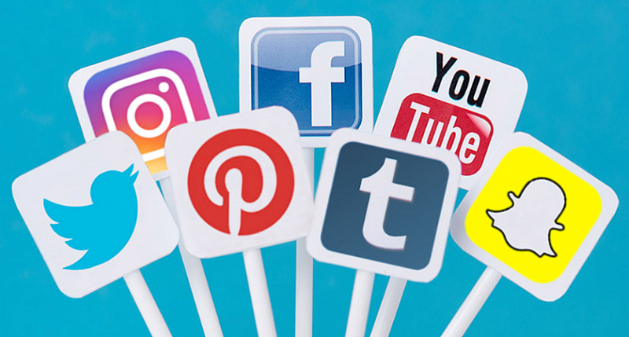
Social Media Stats
There are just over 3 billion active Internet users
Nearly 2.46 billion people have social media accounts

Slide 4
Most Popular Social Media Sites

Slide 6
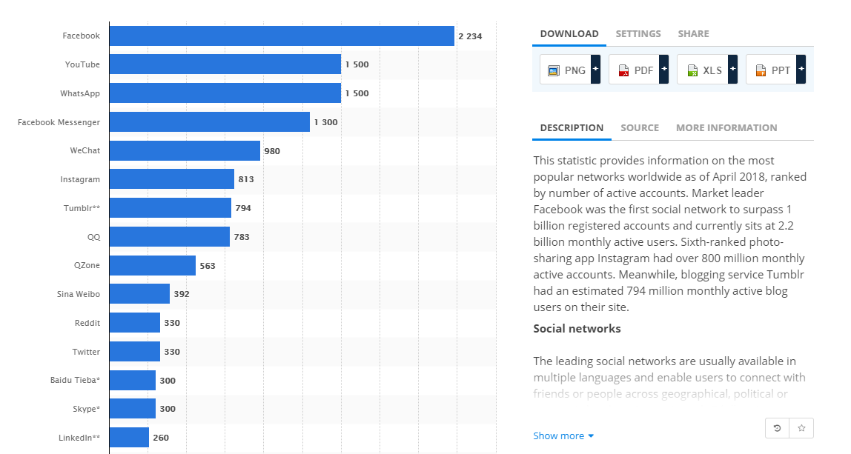

Slide 7
Facebook
As of April 2018, Facebook is the most popular social media site world wide
There are nearly 1.4 billion Facebook users
4.5 billion likes are generated daily
Table shows the most popular activities on Facebook

Slide 8
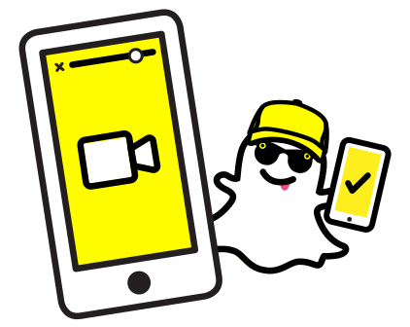
Snapchat
191 million daily active users in 2018
Launched in 2011, Snapchat ranks among the most popular social apps in the USA and Canada
According to teens in 2017, Snapchat is the most important social network of their generation (ahead of Instagram)
1/3 of adult users are between the ages of 18 and 24

Slide 9
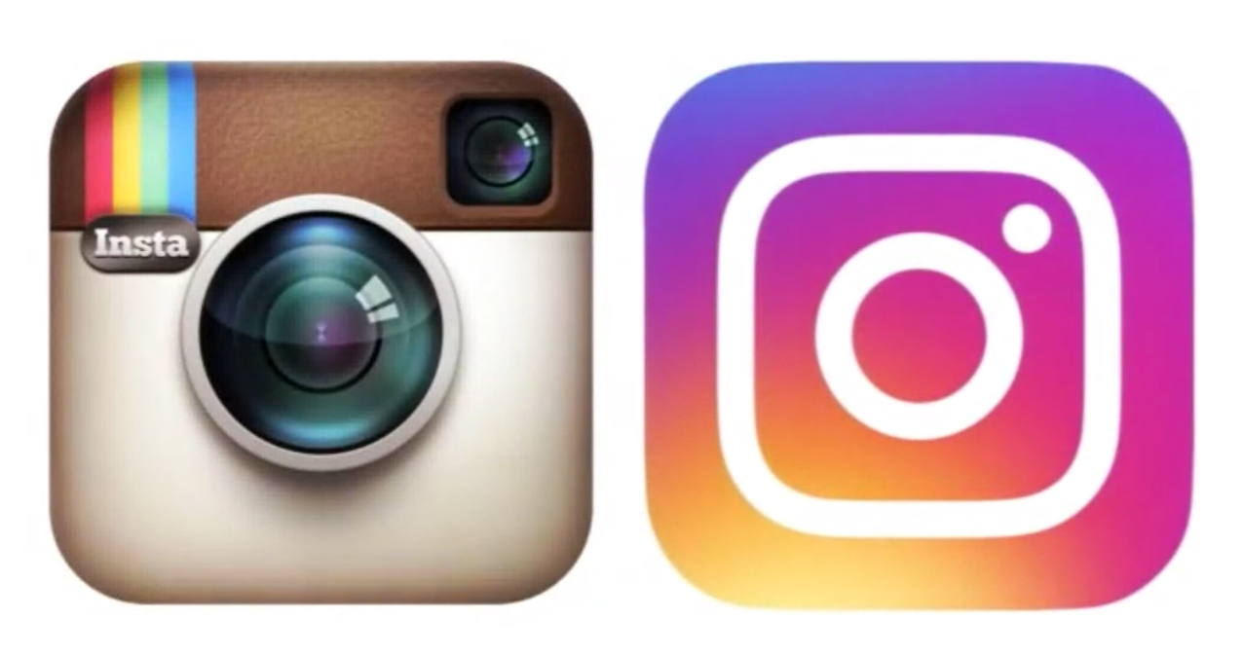
Instagram
In 2015, there were approximately 77.6 million active Instagram users in the USA – this is projected to surpass 111 million users in 2019.
Half of Instagram’s user base is between 18 and 29 years old.
41 percent of users are 24 years or younger.
98% of fashion brands have an Instagram profile.

Slide 10
Digital Footprint
AND YOUR CAREER

Slide 11
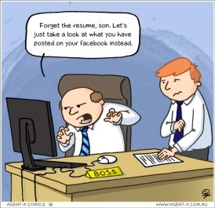

Slide 12
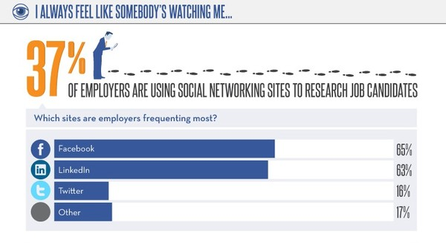
Digital Footprint and Your Career
2 in 5 companies browse your social media profiles to evaluate your character and personality.

Slide 13
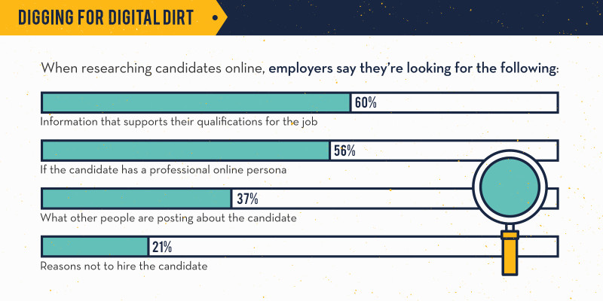

Slide 14
Digital Footprint and Your Career
34% of employers who scan social media profiles said they have found content that has caused them NOT to hire the candidate.
About half of those said they didn’t offer a job candidate the position because of provocative or inappropriate photos and information posted on his/her profile.

Slide 15
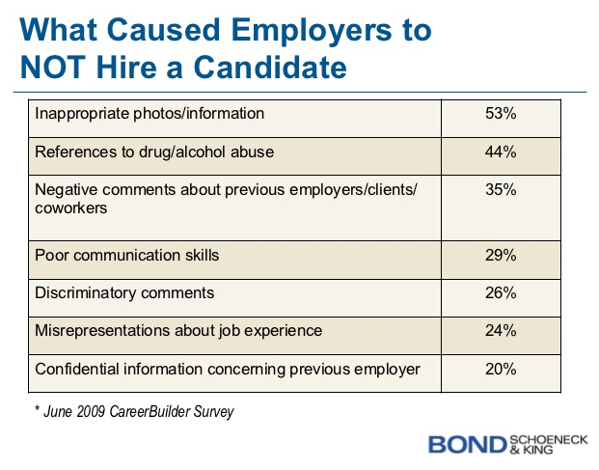
Digital Footprint and Your Career
45% of employers said they chose NOT to hire someone because of evidence of drinking and/or drug use on his or her social media profiles.

Slide 16
How To Manage Your Social Media
Use privacy settings
Keep a list of accounts, delete the ones you no longer use
Don’t overshare
Google yourself
Go through your posts and delete anything that may shine a negative light on you
Posting/Sending anything is forever – the Internet never forgets
Browsing habits are not private – Google, Facebook, etc. record all information and use it to target specific demographics

