Slide 1
Introduction to WorkSafeBC
Career Life Education

Slide 2
Think back to our guest speaker – Michael Lovett….
Answer the true or false question on your handout
Please do this individually

Slide 3
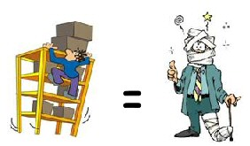
1. True or False
Young workers have the same risk of injury on the job as other workers do.

Slide 4
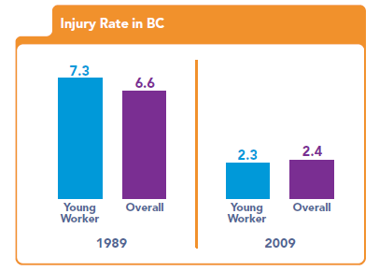
FALSE
Young people between the ages 15-24 are particularly vulnerable to work-related injuries.
They’re eager to please and have much to offer, but typically lack the experience to judge what’s safe and what’s not.

Slide 5
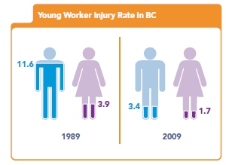
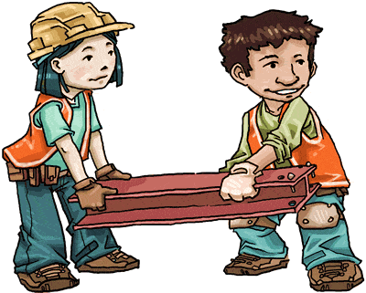
FALSE
More than 50% of work-related accidents happen during a young worker’s first six months on the job.
Males under 25 are much more likely to be injured on the job than any other workers.

Slide 6
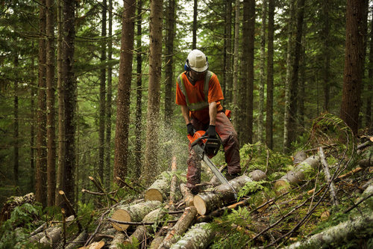
2. True or False
Jobs in industries such as construction and forestry are the most dangerous for young workers.

Slide 7
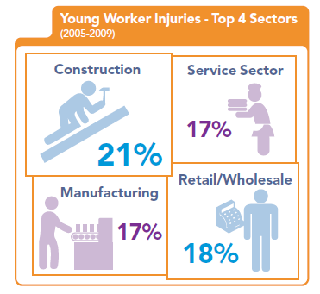
FALSE
While it’s true these industries can be hazardous, most of BC’s youth work in restaurants, supermarkets and retail stores.
These sectors have the highest rate of injury for young workers.

Slide 8
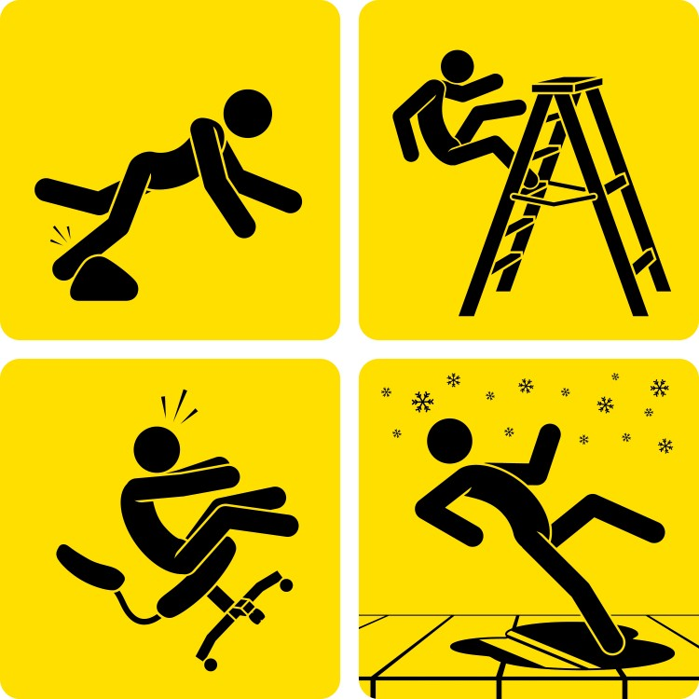
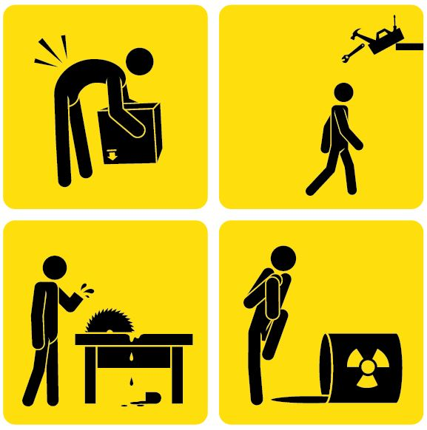
3. True of False
Injuries to young workers are often major ones.

Slide 9
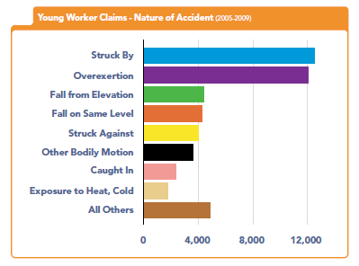
TRUE
Common injuries to young workers include fractures and dislocations.
Some may be severe such as amputations, broken backs and third-degree burns. These injuries can mean permanent impairment, disfigurement and disability.

Slide 10
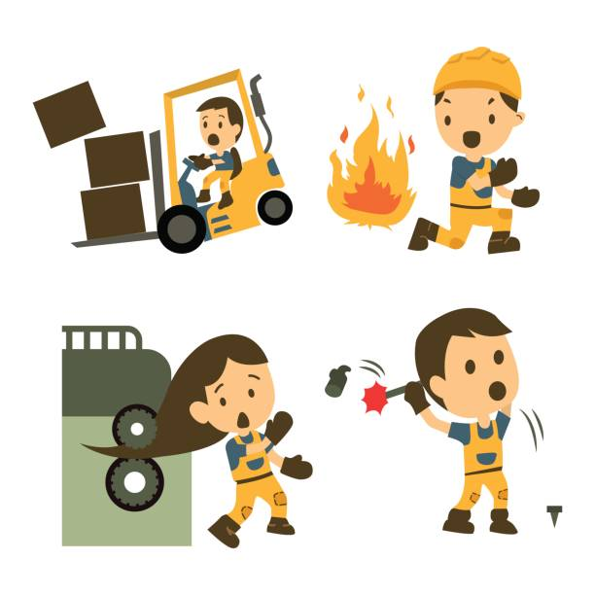
TRUE
Each day in BC, 30 young workers are hurt on the job, or one every 48 minutes.
Every week, five of these young workers are permanently disabled in workplace accidents.
In 2006, 9 young workers were killed in work-related accidents.

Slide 11
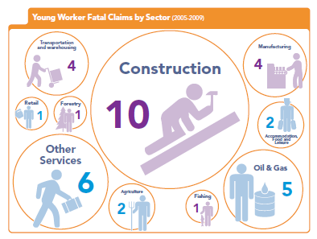

Slide 12
4. True of False
Young workers don’t have any health and safety rights on the job – they can get fired for speaking up.

Slide 13
FALSE
All workers in BC are protected by the Workers Compensation Act. This legislation says that employers must provide all employees with a safe workplace, adequate training and supervision, and properly maintained and functioning safety equipment.
Workers also have the right to refuse work if they believe the task or conditions are unsafe.

Slide 14
5. True or False
Only WorkSafeBC can guarantee workplace safety for young workers.

Slide 15
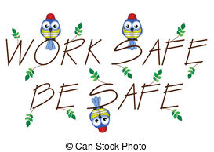
FALSE
Keeping young workers safe is a shared responsibility. Employers, unions, co-workers, parents, educators, youth, the community, and WorkSafeBC all have a part to play.

Slide 16
The Iceberg Effect

Slide 17
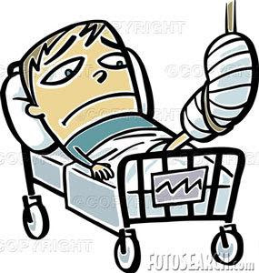
Discuss in your group….
Have you or anyone you know been injured on the job?

Slide 18
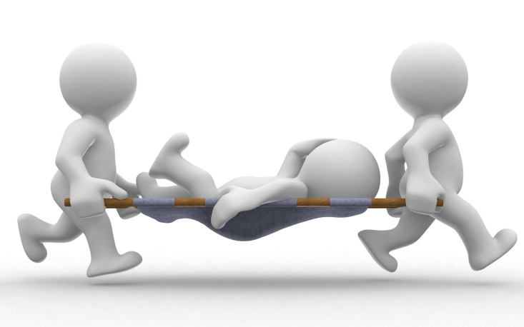
Discuss in your group….
Discuss and come up with a list of jobs or industries that are hazardous.
Describe the sort of hazards and hazardous activities that workers might experience in these jobs/industries.

Slide 19
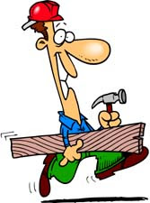
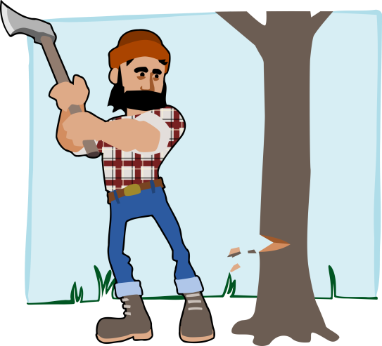
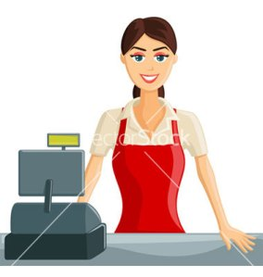
Jobs & Industries that can be Hazardous
Construction
Logging work
Retail work
Warehouse work
Restaurant work

Slide 20
Hazards in the Workplace
Slips, trips, falls
Improper use of equipment
Not turning off power when repairing/cleaning equipment
Being struck by falling objects
Improper use or storage of chemicals
Improper lighting
Improper use of sharp objects
Faulty equipment
Vehicle accidents
Improper lifting
Handling hot items
Cluttered work area
Uneven terrain
Not paying attention
Not falling safety protocols

Slide 21
Top 7 Dangers to Young Workers

Slide 22
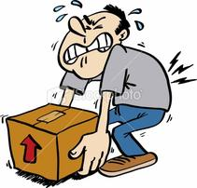
Top 7 Dangers to Young Workers
950 young workers per year
Lifting objects
This happens most often in
the following jobs/careers
Retail clerks
Shippers-receivers
Labourers
Material Handlers

Slide 23
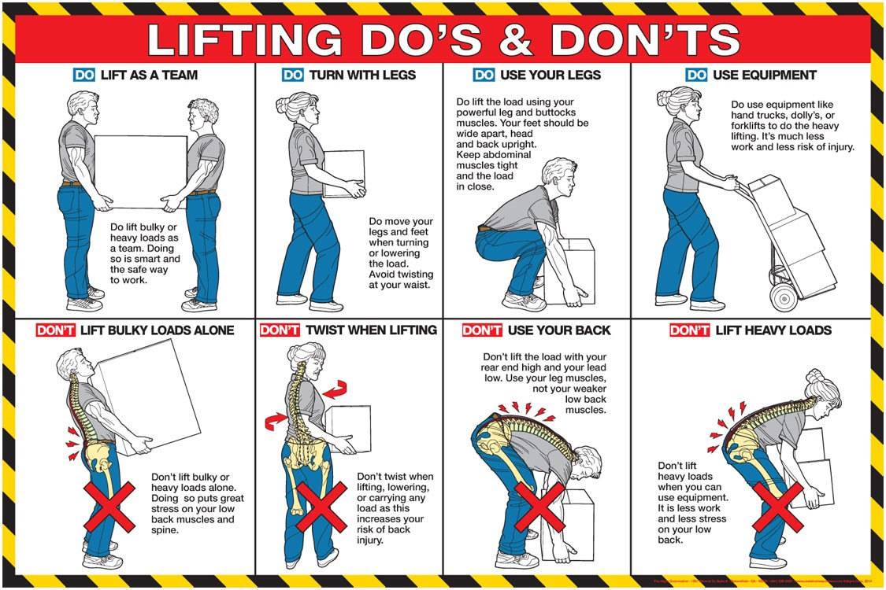

Slide 24
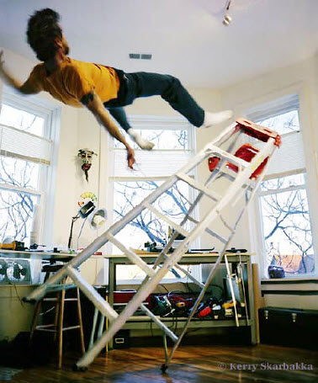
Top 7 Dangers to Young Workers
2. Working on ladders, stairs, scaffolding, other raised areas
900 young workers per year

Slide 25
Top 7 Dangers to Young Workers
3. Using knives in food service, retail sales, supermarkets
525 young workers per year

Slide 26
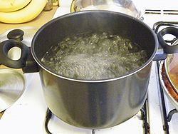
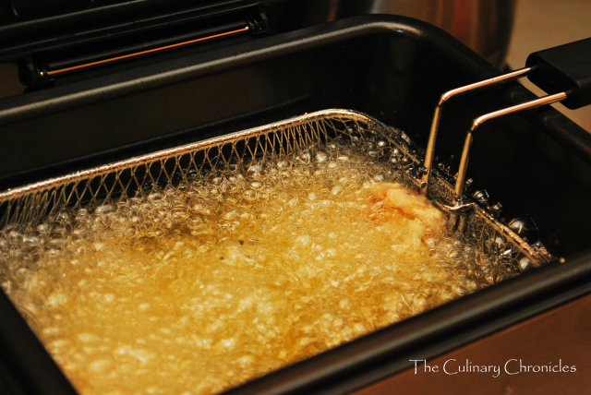
Top 7 Dangers to Young Workers
4. Working with hot substances or equipment in restaurants
350 young workers per year

Slide 27
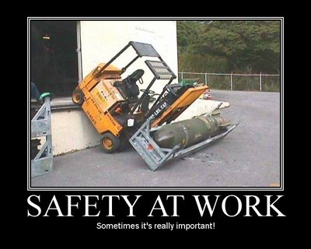
Top 7 Dangers to Young Workers
5. Driving or riding in vehicles and operating or working near mobile equipment
250 young workers per year

Slide 28
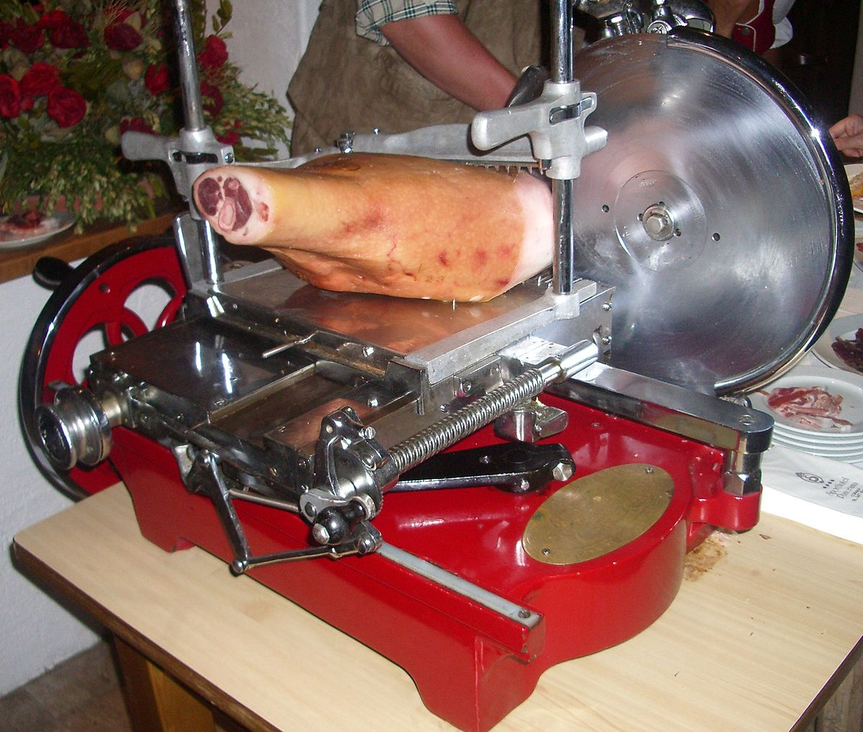
Top 7 Dangers to Young Workers
6. Operating food slicers in restaurants, supermarkets
150 young workers per year

Slide 29
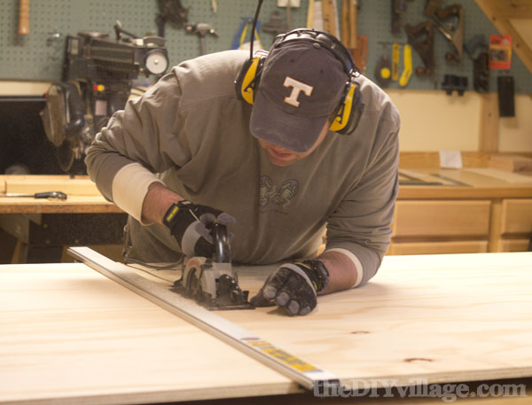
Top 7 Dangers to Young Workers
7. Working near running equipment or machinery in a variety of jobs.
125 young workers per year

Slide 30
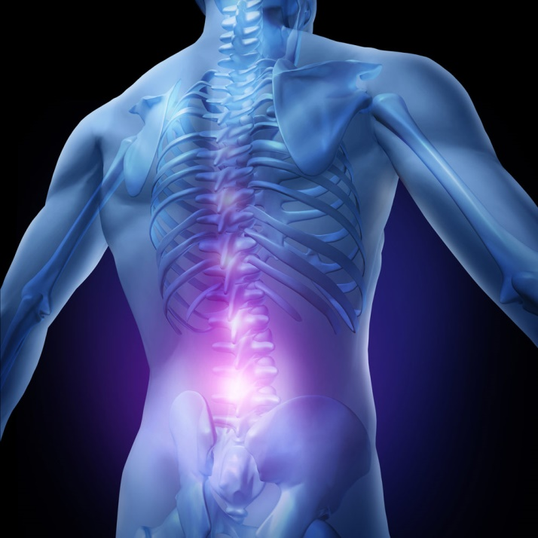
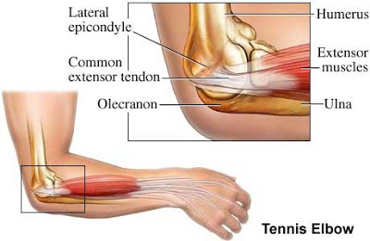
MSI – Musculoskeletal Injuries
A MSI is an injury or disorder of the muscles, tendons, ligaments, joints, nerves, blood vessels or related soft tissue including a sprain, strain and inflammation, that may be caused or aggravated by work.
MSIs result from overexertion and repetitive motion
They account for 1/3 of claims to WorkSafeBC

Slide 31
MSI – Musculoskeletal Injuries
MSIs are often occur gradually from monotonous, repetitive motions such as stocking shelves, lifting boxes, etc.
MSIs are deceptive: you may not realize something’s wrong until it’s too late.
Many young workers ignore the symptoms and consider them just part of the job
Symptoms include pain, numbness, tingling or weakness
Muscle strains to the neck and back, tendonitis, and carpal tunnel syndrome are all examples of MSI-related conditions

Slide 32
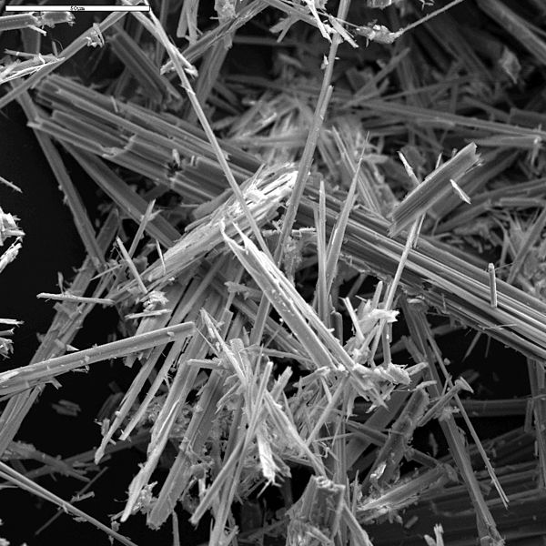
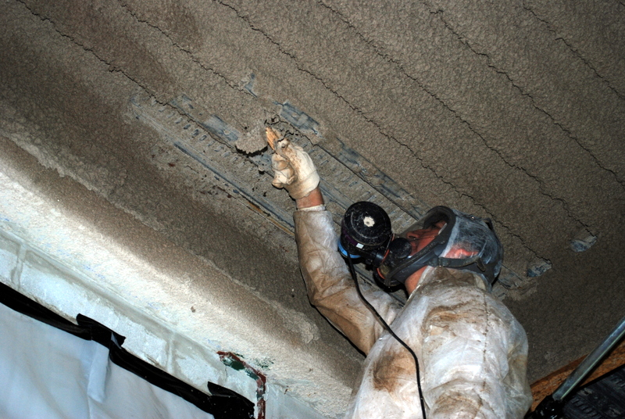
Asbestos
Fibrous material that was once used in many products because it added strength as well as heat and chemical resistance.
Material dries out and crumbles easily – this is when it’s most dangerous as the fibres can be inhaled.
Asbestos in the lungs can cause lung cancer or other serious diseases many years down the road.

Slide 33
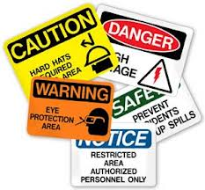
Other workplace hazards
Fatigue
Heat stress
Sun exposure
Noise exposure
Mineral and chemical hazards (lead, cleaning agents, pesticides)
Exposure to biological hazards (HIV, hepatitis, hantavirus, West Nile virus)

Slide 34
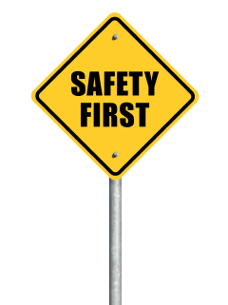
Discuss in your groups…
What are some ways you can keep safe on the job?

Slide 35
The Awareness Test
https://www.youtube.com/watch?v=0grANlx7y2E&list=PL7Xq1zk0ZBvkHYvnmlvk0sa3XYosjyWnf&index=24&t=0s

Slide 36
To keep safe on the job, do the following:
Ask to be trained about safe work procedures and how to recognize on the job hazards.
Follow safety procedures and encourage others to do so.
Know their workplace health and safety rights and responsibilities.
Ask questions if they are uncertain about anything.
Get involved and support young worker health and safety programs.

