Slide 1
Investing 101
Career Life Education 10

Slide 2
Investing 101 – Why Invest?
If you put $1000 in a box and then hide it under you bed for 10 years, how much money would you have in 10 years?
$1000!
Would the $1000 have the same value in 10 years as is does today?
Would you be able to buy as much in 10 years as you can today?
The answer to both is NO!
This is because of INFLATION (the value after 10 years would be ~$600-700
How can we make money grow?
Put it in a savings account
Invest it

Slide 3
Investing 101 – Why invest?
Investing as a student is a wonderful time of life in which to get started in building your financial portfolio.
Investing even just a little bit of money in your late teens and early twenties can grow to thousands of dollars in your middle age.
When you begin investing as a student, you have time on your side.
Here’s what you need to know before starting your portfolio.

Slide 4
Investing 101 – Simple interest
Simple Interest
Simple interest is calculated on the original principal only. Accumulated interest from prior periods is not used in calculations for the following periods. Simple interest is normally used for a single period of less than a year, such as 30 or 60 days.
Simple Interest = p * i * n
where: p = principal (original amount deposited, borrowed or loaned) i = interest rate for one period n = number of periods
Example: You deposit $1000 at 5% simple annual interest, how much will you accumulate after 3 years?
interest = p * i * n = 1000 * .05 * 3 = 150
After 3 years your $1000 will have become $1150.

Slide 5
Investing 101 – Compound interest
Compound Interest
Compound interest is calculated each period on the original principal and all interest accumulated during past periods. Although the interest may be stated as a yearly rate, the compounding periods can be yearly, semiannually, quarterly, or even continuously.
Think of compound interest as a series of back-to-back simple interest contracts. The interest earned in each period is added to the principal of the previous period to become the principal for the next period. For example, deposit $1000 at 5% annual interest compounded annually, after 3 years you will have:
interest year 1 = p * i * n = 1000 * .05 * 1 = 50 (total: $1050) interest year 2 = (p₂ = p₁ + i₁) * i * n = (1000 + 50) * .05 * 1 = 52.50 (total: $1102.50) interest year 3 = (p₃ = p₂ + i₂) * i * n = (1050 + 52.50) *.05 * 1 = 55.13 (total: $1215.51)

Slide 6
Twin Investing
A set of twins, Karen and Bob each received $250 on their 10th birthday from their grandparents.
Karen decided to invest her money at age 10. Bob said “no way I’m too young.”
Karen from age 10 onwards invest $250 a year until the age of 20 and then stopped.
Bob finally started invested at age 20; he also saved $250 a year but continue to do so until the age of 55.
Both Karen and Bob earned an interest rate of 10%.
Who has more money at the age of 55?

Slide 7
Twin Investing
Karen 10-20 $250/year
Bob 20-55 $250/year
Who invested for a shorter period of time?
Karen 10-20 $250/year 10 years total
Bob 20-55 $250/year 35 years total
Who invested more money?
Karen 10-20 $250/year 10 years $2,500 total
Bob 20-55 $250/year 35 years $8.750 total
So who has more money at age 55?
Karen 10-20 $250/year 10 years $2,500 $123,173
Bob 20-55 $250/year 35 years $8.750 $74,532

Slide 8
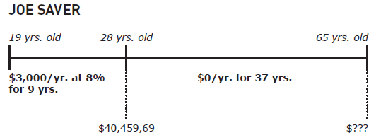
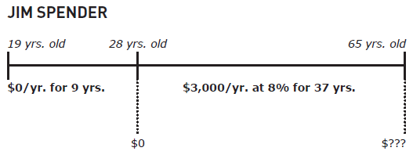
Joe Saver vs. Jim Spender
$697,752
$657,947

Slide 9
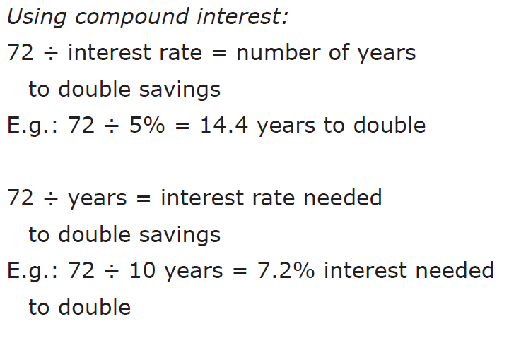
Rule of 72
Anytime you want to know roughly how long it will take to double your money, use the rule of 72.

Slide 10
Financial Institutions
You and Your Bank

Slide 11
What are financial institutions?
In Canada, you can use, banks, credit unions and trust companies for banking services. Each of them provides a range of services and fees vary from one to another.
They run as a business to make profits for their owners and make money by taking in deposits and then using that money to lend to other customers or to invest in other profit-making activities. They pay interest to depositors for the right to use their money
Level of service, fees and interest rates paid to depositors vary because financial institutions vary in their scope of operations; some have more customers and are able to leverage better deals for their customers, some have more efficient business practices or even less services. Some can even pay more interest usually at the cost of limiting depositor withdrawals.

Slide 12
Banks vs. Credit Unions vs. Trust Companies
Bank
A financial institution where you can deposit, withdraw, invest and borrow money. Banks are businesses owned by share holders. (RBC, TD, Scotia, BMO)
Credit Union
A co-operative financial institution where you can deposit, withdraw, invest or borrow money. Credit unions are non-profit organizations that are owned and run by their members. (Ex: Vancity, Coast Capital)
Trust Company
A financial institution, similar to a bank, that can take deposits and make loans. Trust companies often provide other specialized services that banks cannot, like administering estates and pension plans. (Ex: Industrial Alliance Trust, Laurentian Trust of Canada)

Slide 13
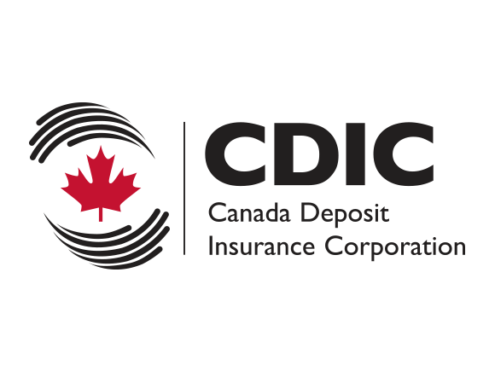
Canada Deposit Insurance Corporation
Depositor insurance is insurance that covers depositors in the event of a financial institution going bankrupt. Most financial institutions are members of the Canada Deposit Insurance Corporation (CDIC) and are covered for deposits in accounts of up to $60,000 CDN but investment accounts are not covered. Credit Unions are covered up to $100,000 per depositor. The CDIC hasn’t had to pay a claim since 1996 which demonstrates that most Canadian financial institutions unlike their American counterparts are based on solid business models first and foremost.
Challenge: Can you name the 5 largest Canadian financial institutions in 2014?
1. _________ 2. _________ 3. _________ 4. _________ 5. __________

Slide 14
5 largest financial institutions in Canada
Royal Bank of Canada (RBC)
Toronto-Dominion Bank (TD)
Bank of Nova Scotia (Scotiabank)
Bank of Montreal (BMO)
Canadian Imperial Bank of Canada (CIBC)

Slide 15
Guide to banking services
Services | Features
Chequing account, savings account or chequing/savings account | A savings account usually pays more interest than a chequing account but has fewer features and different fees. Savings accounts may not allow cheques and can limit withdrawals. A chequing/savings account offers features of both.
Automated teller machines (ATM’s) | Convenient access for withdrawals, deposits and other transactions. There may be extra fees, especially to use machines from other institutions or private machines Prone to fraud (skimming, identity theft).
ATM debit card | Allows you to pay for purchases with money in your account. There may be charges for each transaction, plus annual or monthly fees.
Credit card | Allows you to pay for purchases with BORROWED money. Charges interest on amounts unpaid after a SHORT grace period (usually 18 days). There are usually annual fees. Prone to fraud (skimming, identity theft)

Slide 16
Guide to banking services (con’t)
Services | Features
Telephone and online banking | Allows you transfer money, pay bills and do other business without visiting a branch. There may be extra fees for this type of service. Prone to scams (phishing).
Automatic deposits and payments | No need to visit the branch or remember to make payments. You must be sure your balance will cover automatic payments and when they come out of your account. Some banks offer rewards (e.g. Airmiles) for setting up your account as such.
Account transfers | May be by ATM, online or in person. You may be able to transfer money to accounts within the same institution or a different one. Fees may apply.
Overdraft protection | Will cover cheques you write or withdrawals you make even if there’s not enough money in the account. Interest charges and monthly fees will apply. Not everybody can qualify for this service.

Slide 17
Guide to banking services (con’t)
Service | Features
Traveller’s cheques | A traveler's cheque is a preprinted, fixed-amount cheque designed to allow the person signing it to make an unconditional payment to someone else as a result of having paid the issuer for that privilege.
Money order | Can be acquired from a bank or even a post office. Provide the representative with the funds, as well as the name of the recipient, and you will be presented with a money order for that amount. A small fee is usually involved. Value is typically limited to $1,000 or less.
Certified cheque | Just like a regular cheque from your bank account. Means that the bank guarantees that there are funds in your account to accommodate this cheque, typically setting the money aside so that it cannot be touched. For larger purchases (e.g. car) Small fee applies.
Safety deposit box | Is an individually-secured container, usually held within a larger safe or bank vault. Used to hold valuable possessions. Fees apply.

Slide 18
Guide to banking services (con’t)
Services | Features
US dollar accounts/foreign exchange | Can hold funds in US dollars. Benefit from favorable exchange rates. Banks can convert your CDN dollars to popular foreign currencies (e.g. Euro, Pounds, Rupees)
Line of credit | You can borrow money as you need it up to a pre approved limit. Usually charges a lower rate than credit cards.
Loans | You can borrow money through student loans, car loans, mortgages, etc.
Credit union | A non-profit financial institution that is owned and operated entirely by its members. Provide financial services for their members, including savings and lending.
Investment services | Most banks today can provide added services to their customers that include: Registered Retirement/Education Savings Plans (RRSP/RESP), mutual funds and web-based stock trading (e.g. TD Waterhouse)

