Slide 1
My First Car Assignment
Notes:
To be done as a class.

Slide 2
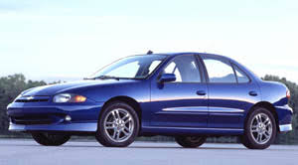
Vehicle - 2004 Chevrolet Cavalier Z24 4 door sedan
List price - $22,025.00
Sales tax 7% - $1542.00
GST 5% - $1101.25
Total Cost - $24,668.25
10% down payment - $2466.83
Loan amount - $22,201.42
Notes:
Can look online for used or new vehicles.

Slide 3
Different Loans - Interest Rates
Loan Amount ($) | 22,598 | 22,598 | 22,598
Term (months) | 48 | 48 | 48
Interest Rate | 6% | 8% | 10%
Monthly Payment ($) | 531 | 552 | 573
Total of Payments ($) | 25,474 | 26,481 | 27,511
Total Interest ($) | 2,876 | 3,888 | 4,913
Notes:
Different options in amount of % you will be paying… which one is the best?

Slide 4
Different Loans - Payment Terms
Loan Amount ($) | 22,598 | 22,598 | 22,598
Term (months) | 36 | 48 | 60
Interest Rate | 8% | 8% | 8%
Monthly Payment ($) | 708 | 552 | 458
Total of Payments ($) | 25,493 | 26,481 | 27,492
Total Interest ($) | 2,895 | 3,883 | 4,894
Notes:
Different Options in the amount of time it take to pay off… which one is the best?

Slide 5
Calculating your loan
Loan Amount – $22,598
Interest Rate (You choose) – 8%
Simple Interest – (22598 x 0.08) $1807.84 every year
Years to pay off (You choose) – 4 years (48 months)
Total Interest you will pay after 4 years – 4 years x $1807.84 = $7219.36
Total Payment (Interest + Principal)
(7219.36 +22598) = $ 29817.36
Monthly Payment (Total Payment / Months)
(29817.36 / 48) = $621.20
Notes:
10 years max

Slide 6
Insurance cost factors
Rate classes
Where you live
Your claim record
Vehicle
Additional coverage
ICBC.ca

Slide 7
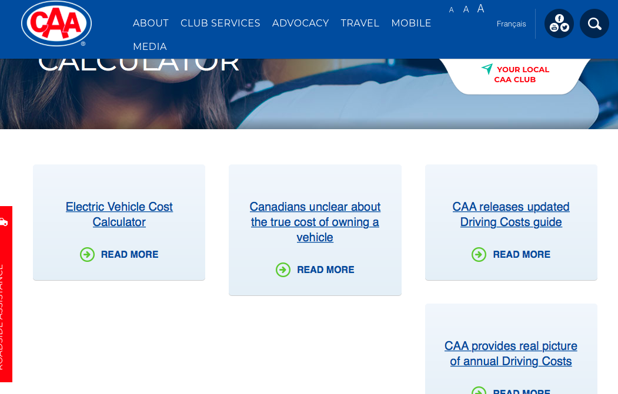
Monthly insurance costs - www.caa.ca
Go to www.caa.ca
Search “Cost Calculator”
“CAA provides real Picture of annual Driving Costs”

Slide 8
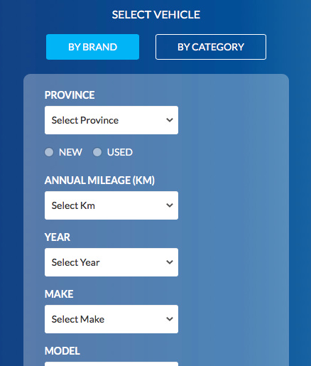
Monthly insurance costs - www.caa.ca
“CAA provides real Picture of annual Driving Costs”
Select “Driving Costs”
Fill in options. If you have an old car just do the closest year and options.
Annual Mileage - How much will you be driving the vehicle?
Notes:
Website can be slow…

Slide 9
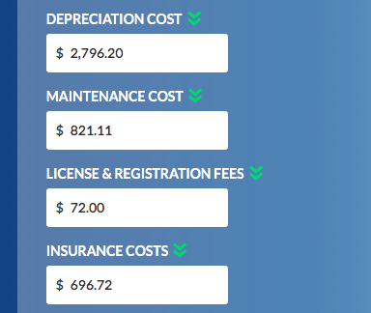
Monthly insurance costs - www.caa.ca
Costs are for the year.
Calculate Monthly Insurance costs by taking the annual rate and dividing by 12.
For example, $696.72/12 = $58.06 per month
Notes:
Website can be slow…

Slide 10
Some Monthly Maintenance Costs
Fuel Belt replacement
Tires Cleaning battery
Oil Changes Cabin air filter
Brakes Engine air filter
Windshield Wipers Spark plugs
Anti-Freeze

Slide 11
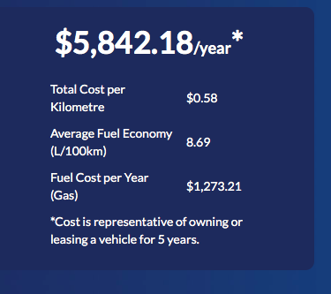
Monthly Maintenance Costs - Fuel
Again, use the website. www.caa.ca
Remember to divide by 12 to get the monthly costs.

Slide 12
Monthly Maintenance Costs - Maintenance
Again, use the website. www.caa.ca
Remember to divide by 12 to get the monthly costs.

Slide 13
Adding it all up! Your total monthly costs
Vehicle: 2004 Cav
Financing (Your monthly loan payment)- $621.00
Insurance (www.caa.ca) - $58.06
Maintenance (www.caa.ca) - $68.43
Fuel (www.caa.ca) - $106.10 Total $853.79

Slide 14
Example: My First Car

Slide 15
Vehicle - 2004 Chevrolet Cavalier Z24 4 door sedan
List price - $22,025.00
Sales tax 7% - $1542.00
GST 7% - $1542.00
Total Cost - $25,109.00
10% down payment - $2511.00
Loan amount - $22,598.00

Slide 16
Vehicle Loan
Loan Amount – $22598
Interest Rate – 8%
Simple Interest – $1807.84 every year
Years to pay off – 4 years (48 months)
Total Interest – $7219.36
Total Payment (Interest + Principal)
= $ 29817.36
Monthly Payment (Total Payment / Months)
= $621.20

Slide 17
Insurance Costs
From www.caa.ca
$696.72/12 = $58.06 per month
Insurance: $58.06

Slide 18
Maintenance Costs
From www.caa.ca
Fuel: $106.10
Maintenance: $68.43

Slide 19
Total Monthly Costs for 2004 Chevrolet Cavalier
Insurance: $58.06
Fuel: $106.10
Maintenance: $68.43
Financing: $621.20
Total Monthly Cost of Vehicle: $853.79

