Slide 1
Myers-Briggs Personality Test

Slide 2
History
There are 4 categories tested based on a prominent psychologist’s ideas of seeing the world: sensing, intuition, feeling and thinking
Some workplaces like to know your result for the type of job they are offering.
There are 16 different results
Do you think there are only 16 types of people?

Slide 3
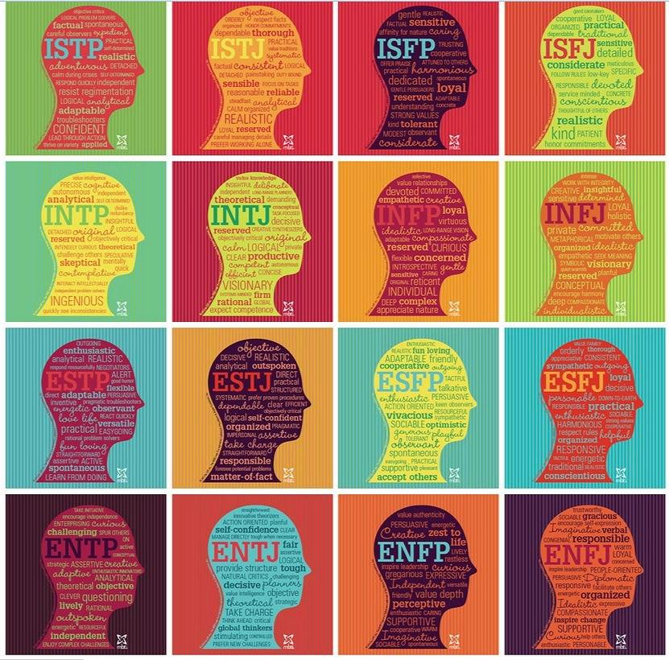

Slide 4
Consider the following...
Is it better to be sensitive or logical?
Is it better to be social or independent?
Is it better to be a concrete thinker or abstract thinker?
Is it better to be highly organized or “go with the flow”?

Slide 5
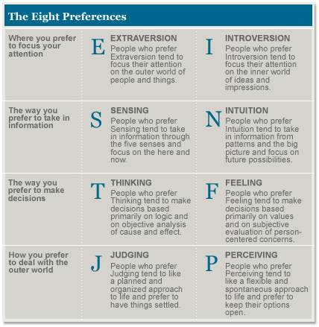

Slide 6
Activities
Take the test on MyBlueprint
Read more information about your result on www.16personalities.com
Optional: take their test and see if your results change
Reflection: (piece of paper - full sentences)
What did you find accurate about your result and not-so accurate?
What jobs are recommended for you? Would you consider them? Why or why not?
Was there any insight from these results for you? Describe.

