Slide 1
Recognizing Workplace Hazards
Can you spot them all?

Slide 2
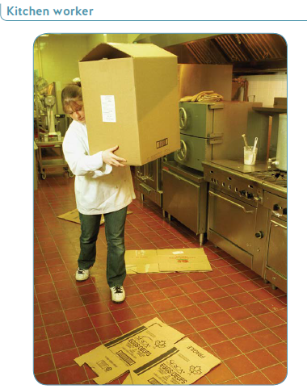

Slide 3
Kitchen Worker
Hazards
Worker cannot see where she is going
Boxes lying on floor – slipping/tripping hazard
Box could be too heavy for worker
Worker could bump into another worker
Worker could fall onto hot stove top
Prevention
Remove debris/boxes lying on floor
Do not walk without seeing pathway
Be aware of other workers working around you
Get assistance with carrying box
Use handcart to move box
Ensure nothing is in pathway
Use proper lifting/carrying techniques

Slide 4
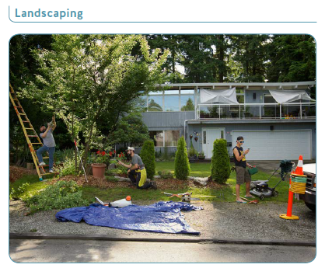

Slide 5
Landscaping
Hazards
Wearing sandals could result in a severe injury when using equipment such as lawnmower
Safety cones not in use
Improper and unsafe ladder use, could result in fall
Lawn mower controls are hidden and cannot be accessed quickly in the case of an emergency
Tools and equipment not secured, creating a tripping hazard
One worker texting while in a hazardous area
Prevention
Wear proper footwear and clothing for the job
Keep workspace clear and uncluttered
Pay attention at all time while on the job, particularly around hazards
Use all equipment as directed – do not use tools or equipment for purposes they were not designed for

Slide 6
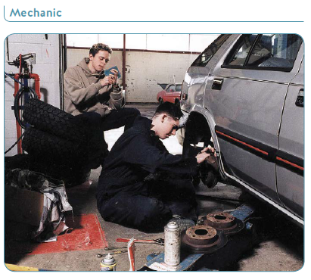

Slide 7
Mechanic
Hazards
Worker not wearing face mask or safety glasses – potential eye or face injury from flying debris or dust
Distracted by other person
Other person sitting on unstable stack of tires, could fall onto worker
Prevention
Wear proper personal protective equipment (dust mask, safety glasses)
Move tires away from car
Do not sit on stack of tires
Clean up work area
Pay attention to task

Slide 8
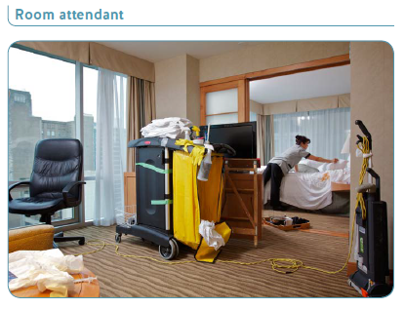

Slide 9
Room Attendant
Hazards
Poorly maintained equipment (broken wheel, taped together cart, taped electrical cord)
Cleaning supplies improperly labelled and stored
Potential biohazards from blood on sheets and syringe on table
Over-reaching could cause strain
Tripping hazards from electrical cord across doorway and food tray on floor
Prevention
Keep all equipment and tools in proper working condition
Ensure all cleaning products and chemicals are properly labelled
Follow ergonomic guidelines for work that requires bending or lifting
Follow proper procedures for handling biohazards such as blood and syringes
Keep workspaces and walkways clear and uncluttered

Slide 10
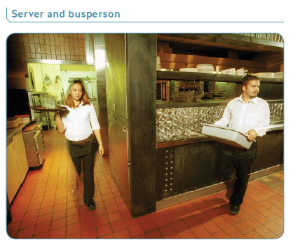

Slide 11
Server and Busperson
Hazards
Potential collision could result in cuts from broken glass or burns from hot liquid
Server holding tray in unstable position (over shoulder)
Server and busperson cannot see each other coming around corner
Busperson not paying attention to oncoming traffic
Server could lose balance
Prevention
Both workers need to pay attention for oncoming traffic
Mirror could be installed so that workers can see oncoming traffic
Use proper technique for carrying tray
Use both hands for carrying tray
Proceed cautiously around corner

Slide 12
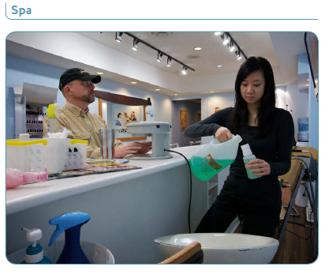

Slide 13
Spa
Hazards
Potential chemical hazards to both worker and customer
Coffee cup is near chemical hazards
Workspace is very cluttered, potential tripping hazard
Liquids stored in a way that spills are likely to occur
Potentially flammable liquids are too close to electrical equipment
Prevention
Wear/use PPE such as gloves, mask/respiratory protection, and eye protection when working around chemicals
Keep food and drinking water away from chemical hazards
Keep workspace clear and uncluttered
Handle and store liquids properly

Slide 14
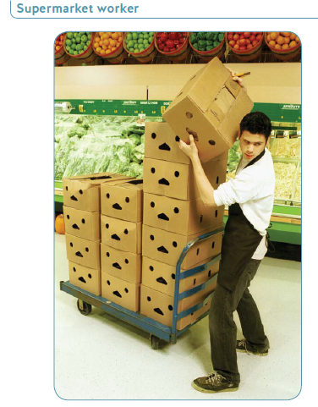

Slide 15
Supermarket Worker
Hazards
Lifting heavy box in awkward position – could cause back strain injury
Lifting box with box cutter in hand – potential for injury
Turning while lifting – could strain back
Improper footwear – slipping/tripping hazard
Repetitive lifting of boxes
Cart could move throwing worker off balance
Prevention
Use proper lifting technique
Do not turn body while lifting
Do not lift boxes with box cutter in hand
Wear proper footwear
Position cart so it can’t move
Get assistance if boxes are too heavy

Slide 17
Traffic
Hazards
Traffic control equipment (cones, signs, etc.) not set up properly
Workers are out of sightlines, behind vehicles, and do not appear to be paying attention to their jobs
One worker is texting/distracted, and is not wearing any high visibility clothing
Prevention
Pay attention at all time when working around any moving equipment, including motor vehicles
Do not text or engage in other distracted behaviour when working in or around motor vehicles
Wear high visibility clothing when working in or around motor vehicles

Slide 18
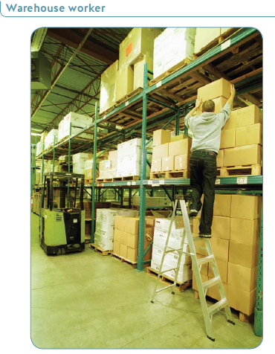

Slide 19
Warehouse Worker
Hazards
Worker is reaching too high to lift box
Worker has leg on second rung of ladder and is in an unstable position – could fall off ladder
Box could be too heavy to lift
Box could fall on worker
Forklift is behind worker – another worker may start operating the forklift
Prevention
Don’t stand on the top two rungs of ladder
Ensure ladder is in correct and secure position
Use proper lifting techniques
Ensure forklift driver is aware of worker on ladder
Ask for assistance with heavy boxes

Slide 20
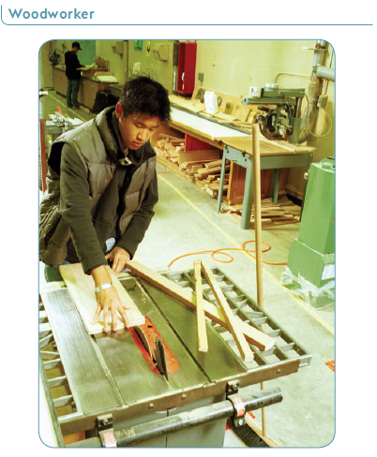

Slide 21
Woodworker
Hazards
Hand is too close to blade
Extra wood pieces in the way of work
Broom leaning on work table, could fall
Extension cord behind worker – tripping hazard
General mess in shop
No guard on saw
Loose jewellery and clothing on worker – could get caught in machinery
Prevention
Keep fingers at least 8 cm from saw blade
Ensure there is not clutter around saw area
Move broom away from table saw
Have guard on saw
Ensure safe work procedures are followed for working on saw
Clean up work area
Do not wear loose jewellery or clothing while working on saw

Slide 22
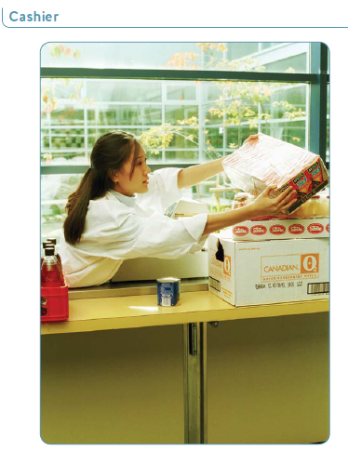

Slide 23
Cashier
Hazards
Worker is reaching over stacked items and overextending arms – could strain arms, shoulder, or back from awkward lifting
Item may be too heavy for lifting
Items not stacked properly
Items could fall on worker if knocked over
If glass items broken, worker could get cut
Prevention
Do not overextend or twist body
Use proper lifting techniques
Ask for assistance in lifting heavy items
Use proper posture while working

Slide 24
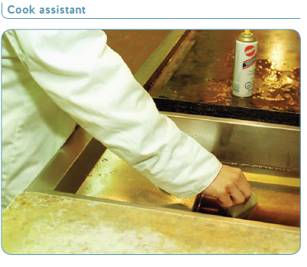

Slide 25
Cook Assistant
Hazards
Grill Could be hot
Cleaning sponge is small, worker’s fingers could get burned
Flammable aerosol can could explode from heat
Worker’s fingers could get burned from hot grill or oil
Worker’s long sleeve could get hot oil on it
Prevention
Remove aerosol can from hot area
Wear proper clothing (no wide sleeves or sleeves too long)
Use proper cleaning tools
Use safe work procedures for cleaning grill

Slide 26
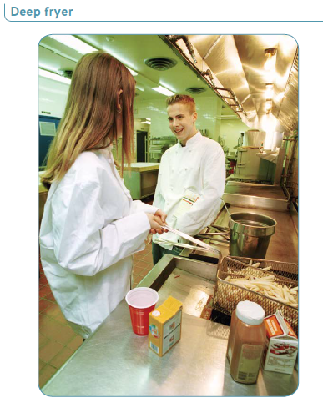

Slide 27
Deep Fryer
Hazards
Worker is not paying attention to task
Kitchen items are too close to deep fryer – Could fall into fryer causing hot oil to splash up
Second worker could knock over hot items
Worker’s hair not tied back, could get in way
Prevention
Pay attention to task
Remove items or utensils that are too close to deep fryer
Tie back hair
Ensure safe work procedures are followed for deep frying

Slide 28
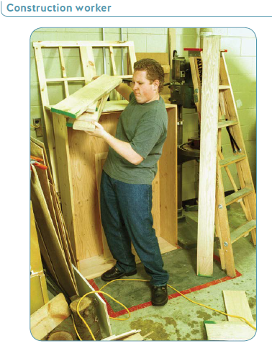

Slide 29
Construction Worker
Hazards
Wood items are stacked in unstable position – items or ladders could fall onto worker
Awkward lifting and handling of wood items by worker – worker could get back injury from awkward lifting
Extension cord lies across the work area – tripping hazard
Worker not wearing safety gloves – hand could get cuts or slivers
Messy/cluttered area
Prevention
Weak work gloves
Use proper lifting techniques
Ensure path or walkway is clear
Move ladders and extension cord away from work area
Ask for assistance if required

Slide 30
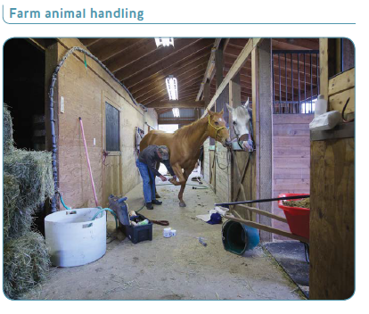

Slide 31
Farm Animal Handling
Hazards
The hay is stored improperly and represents a fire hazard
Tools and bucket are potential tripping hazards
Horse is not secured
The worker’s body position is an ergonomic hazard
Syringes lying on floor are both a biohazard and a puncture hazard
Potential biological hazards when working around animals or animal waste
Worker appears to be alone
Prevention
Keep work area uncluttered and free of tripping hazards
Store hay and other flammable materials safely
Dispose of biological waste safely
This type of work would be better done with a second worker restraining the animal
Follow ergonomic practices to avoid MSIs
Wear PPE and follow proper procedures to avoid biological hazard when working with animals
Make sure there’s a communication plan for workers working alone.

Slide 32
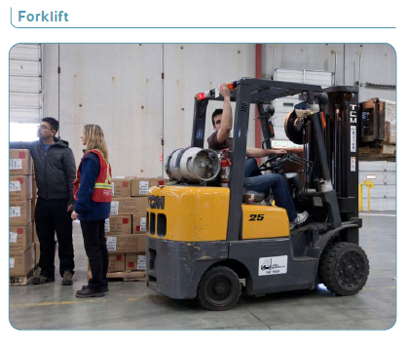

Slide 33
Forklift
Hazards
Workers not paying attention to moving equipment
Not all workers are wearing high-visibility apparel
Forklift is operating outside designated area; markings on floor are unclear
Forklift operator is not wearing seatbelt, and has parts of his body outside the forklift
Cup of coffee on forklift is a spill/slipping hazard
Load on forklift is trailing debris that could snag on equipment or cause other workers to trip
Prevention
high visibility clothing when working in or around moving equipment
Pay attention at all times when working in or around moving equipment
Follow all safe work procedures for hazardous equipment such as forklifts
Keep equipment properly maintained and clutter-free

