Slide 1
S.M.A.R.T. Goals

Slide 2
What is a goal?
A goal is a desired outcome that will make a difference in your life after you’ve achieved it.
Many types:
Academic
Extracurricular
Community
Education
Career
Personal

Slide 3
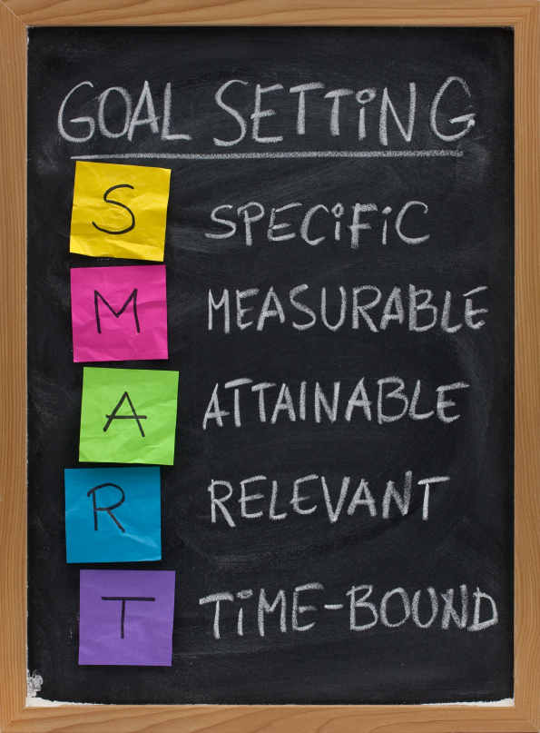
S.M.A.R.T. Goals
(Achievable)
(Realistic)

Slide 4
S - Specific
Be specific rather than general
Answer the 5 W’s
Who – who is involved?
What – what do you want to accomplish?
Where – identify location (eg school)
Which – identify requirements and constraints
Why – specific reasons, purpose or benefits of accomplishing this goal
(not specific) “I want to do better academically”
(specific) “I want to improve my science grade from a C+ to a B”

Slide 5
M - Measurable
You should be able to measure your progress toward reaching your goals
Answer the questions:
How much?
How many?
How will I know when my goal is accomplished?
(not measurable) “I want to lose weight”
(measurable) “I want to lose 10lbs”

Slide 6
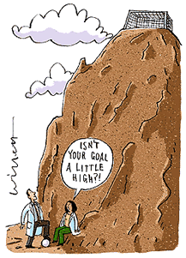
A – Attainable (Achievable)
Goals need to be attainable. If they are too far out of reach it will be difficult to commit.
Answer the question
How can my goal be accomplished?
What steps do I need to take?
(not attainable right away) “I want to run a marathon”
(more attainable) “I want to be able to run 5 km without stopping.”

Slide 7
R – Relevant (Realistic)
Choose goals that matter
Ask yourself
Does this seem worthwhile?
(not relevant) “Make 50 peanut butter and jelly sandwiches by 2:00pm” may be Specific, Measurable, Attainable and Time-Framed but it’s not relevant.
(not realistic) “Never eat sweets again”
(realistic) “I will only eat 1 sweet per week”

Slide 8
T – Time Frame
Set a time frame or target date
Ask yourself
When do you want to have achieved your goal?
When do you plan on working towards this goal?
Time frames
Short-term (this school year)
Medium-term (before graduation)
Long-term (after high-school)

Slide 9
Develop an Action Plan
Ex: I will raise my grade from 62% to 70% in math
Action Plan:
Spend 2 hrs/week prepping for quizzes/tests
Spend an extra hour/week on math homework
Attend math tutorials offered by my teacher at lunch time
Participate in class and ask questions

Slide 10
Self-Assess and Reflect
During your action plan ask yourself:
Why is this goal important to me?
How could I modify this goal to make it more attainable?
Who can support/help me achieve this goal?
Do I need to add more steps to my action plan?

Slide 11
Self-Assess and Reflect
After you’ve achieved your goal, ask yourself:
What did I do well?
What am I most proud of?
What barriers did I run into and how did I overcome them?
What have I learned?

Slide 12
Example goals
Not S.M.A.R.T. | S.M.A.R.T.
Specific: “Do well in math” | S: “Get 80% in math”
Measurable: “Get healthy” | M: “Exercise for 30 min 2x a week”
Attainable: “Bank $500,000 in a month” | A: “Bank 10% of what I earn each month”
Relevant: “Become a rock star” | R:“Learn how to play the guitar”
Timely: “Finish Halloween costume” | T: “Finish costume by Oct. 15”

Slide 13
Example steps for your action plan
GOAL | ACTION PLAN
“Get 80% in math” | Find a math tutor
“Exercise for 30 min 2x a week” | Get a gym membership
“Bank 10% of what I earn each month” | Spend less money on clothes
“Learn how to play the guitar” | Practice for 30 min a day
“Finish costume by Oct. 15” | Spend 1 hr on costume 3x/week

Slide 14
Now let’s set some goals!

