Slide 1
The Credit Game
Powerplay

Slide 2
The Rules
Each turn represents a new purchase.
Purchase amounts = $1000 (every time)
Annual interest rate = 18%

Slide 3
Steps
Start with $0 in interest and no missed payments.
Roll the die and follow the actions below.

Slide 4
Goal
Pay the lowest amount of interest and have no missed payments.

Slide 5
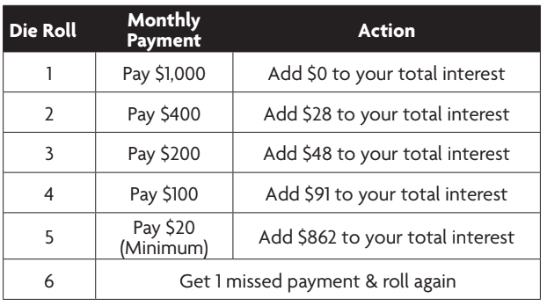

Slide 6
Let’s compare the impact of interest rates
After doing 6 rounds of game… Award winner.

Slide 7
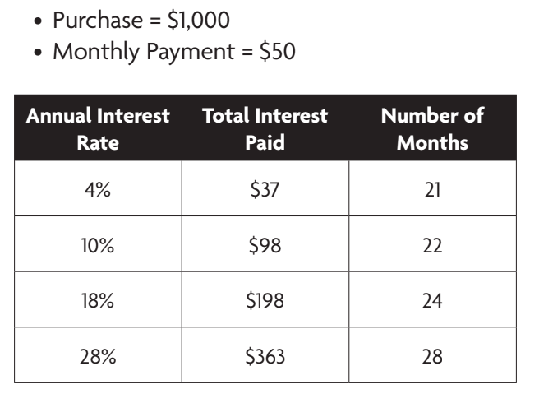
Impact of Interest Rates

Slide 8
2nd round of the game.
Each turn represents a new purchase on a DIFFERENT card.
Different card = interest rates can be different.

Slide 9
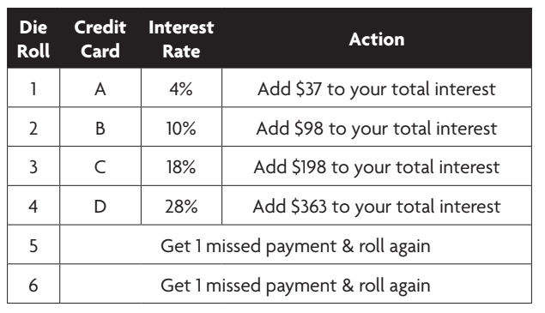
2nd round of the game.

Slide 10
What success strategies can you come up with for using credit cards?
Think Pair Share

Slide 11
What success strategies can you come up with for using credit cards?
Set reminders
Pay off right away
Find lowest interest rate
Have only 1 card so it’s easier to keep track
…?

