Slide 1
Top 5 Tips for Marketing Yourself Successfully
Career Life Education 10

Slide 2
1. Transferable Skills
Understanding your skillset, where you’ve developed those skills and how they will translate into the workplace is the best place to start in being able to market yourself.

Slide 3
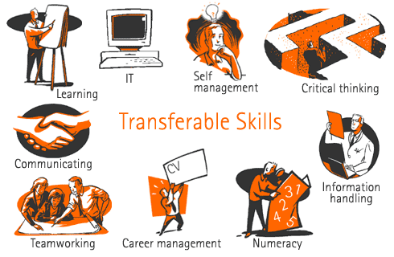
1. Transferable Skills
Did you write essays in school? That takes written communication skills.
Have you worked in group projects? That takes teamwork and leadership skills.
Prepared for exams? Time management and organizational skills.

Slide 4
1. Transferable Skills
Think – Pair – Share
What skills have you acquired in the following classes?
English
Math
Science
PE
Social Studies
French (or other languages)

Slide 5
2. Networking
Networking provides the perfect opportunity to market yourself.
Building a network is invaluable as it provides links to individuals and organizations who may be able to help you find a job, help you get into a post-secondary institute, or obtain an internship.

Slide 6
3. Elevator pitch
An elevator pitch is a clear, concise introduction that can be delivered in the time it takes to ride an elevator from the top to the bottom of a building – usually 30-60 seconds.
Summarize your key skills and abilities and make sure to mention what makes you unique.

Slide 7
3. Elevator Pitch
At this point in your life, it will probably include what you’re studying in school, any major volunteering, clubs or extra-curriculars you partake in and where you want to be after graduation.
People normally give their elevator pitch when meeting new people at a networking event, but it can also make a great summary for the interview question, “Tell me about yourself.”

Slide 8
4. Portfolio
A portfolio is made up of examples of your past work and accomplishments.
Many careers in creative or technical fields require you to keep a portfolio.
Journalism
Graphic design
Hairdressing
Makeup artistry
Marketing
Architecture
Project Management
Photography

Slide 9
4. Portfolio
Some post-secondary institutions will as for a portfolio as a requirement.
Always save copies of your best work.
Possible items to include:
Projects or assignments
Reports or essays
Performance evaluations
Letters of recommendations you’ve received.
Or anything else that shows you’ve worked hard and excelled

Slide 10
5. Social Media
You can use social media platforms to network, build a portfolio and establish a personal brand.
LinkedIn
Twitter
Instagram
Facebook

Slide 11
5. Social Media
Twitter or Instagram are great tools for staying up to date with your industry.
Follow professionals you admire.
Post links to interesting articles.
Participate in relevant chats.
You can also post examples of your own work.

Slide 12
5. Social Media
LinkedIn is useful when you’re actively looking for a job.
It will show you job postings and tell you if any of your connections know someone at a company you’re interested in working at.
It’s an excellent site for building your network.

Slide 13
5. Social Media
Facebook is a great tool where you can run a page or a group.
This is an easy way to promote your business, your interests, and yourself.
Making a group allows you to connect with other members of your community that share similar interests as you.

Slide 14
5. Social Media
While social media platforms can be a great way to network and market yourself, you also have to be careful and keep it professional.
One of the first things employers do is Google your name. If they find any inappropriate photos, that you prevent you from getting the job.
Anything you post, ask yourself, would you want your boss to see this?

Slide 15
The Elevator Pitch
Career Life Education

Slide 16
What is an elevator pitch?
An elevator pitch is a clear, concise introduction that can be delivered in the time it takes to ride an elevator from the top to the bottom of a building, usually between 30 and 60 seconds.
Your elevator pitch is a way to share your expertise and credentials quickly and effectively with people who don't know you.

Slide 17
When to use an elevator pitch?
Job searching
Career or job fairs
Informational interviews
Online bio (LinkedIn, Twitter, Facebook)
Networking events or any other gathering
Job interviews
Use it as your opening to the question “Tell me about yourself”

Slide 18
What to say
Name
Industry or field (still in school? What area are you interested in pursuing?)
Skills & Accomplishments
What you want to do, what you’re looking for
What you enjoy doing in your current position
What you’re interested in the listener’s company/industry
What sets you apart from others

Slide 19
Tips for Success
Keep it brief – 30 to 60 seconds
Be persuasive, sell yourself!
Share your skills, what can you offer them
Practice, practice, practice
Be flexible, be open-minded
Mention your goals
Have a business card ready

Slide 20
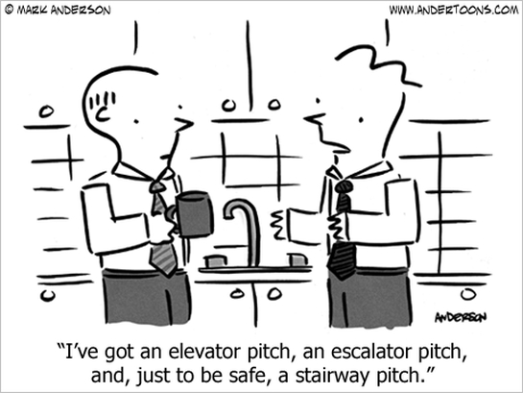
What to Avoid
Don’t speak to fast
Avoid rambling
Don’t frown
No monotone voices
Don’t restrict yourself to a single elevator pitch. Have a few different versions you can tailor to the specific listener.

Slide 21
Examples
Hi, I’m Lil Lulu, a grade 12 student at Panorama Ridge, looking for a summer job. Two classes I’ve excelled in are math (90%) and Computers (85%). I’ve previously worked in retail at ComputersRUs where I gained experience working with an inventory management systems. I’m proficient in Excel, Word & PowerPoint. I spend my spare time volunteering at Habitat for Humanity. My previous managers both said they’d be a reference for me. If you need an enthusiastic, proactive person for the summer to off-load work to, I’m your girl. Again, I’m Lil Lulu. Thank you.

Slide 22
Examples
Hi, I’m Bob the Builder. I’m a grade 11 student at Panorama Ridge and I’ve just been accepted into the district carpentry program. Ever since I can remember I’ve loved building and creating things. I’ve recently finished a hand-carved oak table for my parents dining room. Recently I’ve been spending my weekends helping out around a construction site at my dad’s company, but I’m looking to obtain a more official position at a reputable construction company. Here’s one of business cards with a link to my Instagram account where I post images of my various wooden creations. Again, I’m Bob the Builder, thank you for your time.

